Slide 1
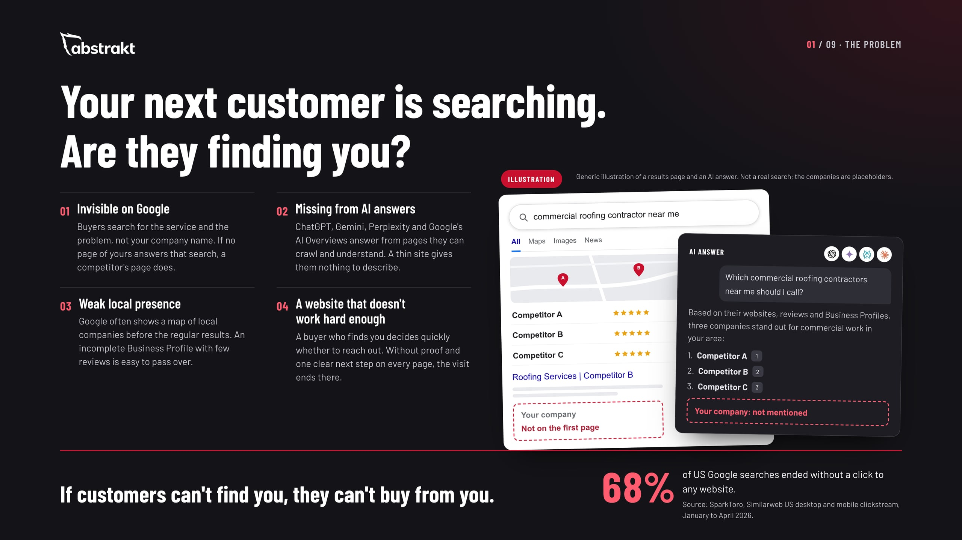
Notes:
Open with the buyer, not with us. Every commercial buyer checks you out online before they reach out or take a meeting, and more of them now ask an AI assistant first. Walk through the four places a company loses that buyer: it doesn't show up for the search, the AI answer doesn't mention it, the map shows competitors, or the website gives no reason to call. The 68% figure is SparkToro's, from Similarweb data on US searches, January to April 2026: most searches end on the results page, so what shows there matters. Ask: when you search for your own service in your area, who comes up?

Slide 2
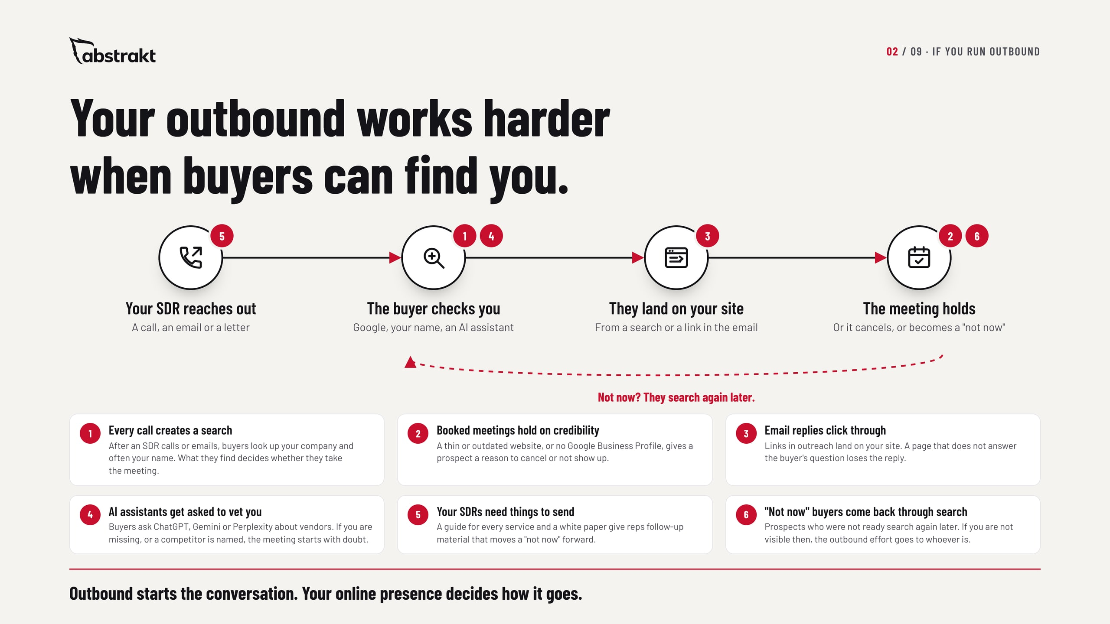
Notes:
If they run outbound, or plan to, this is the slide that connects the two. Walk the path from left to right: the SDR reaches out, the buyer checks you on Google and increasingly in an AI assistant, they land on your website, and the meeting either holds or it does not. Each red number is a place the path leaks. A buyer who finds nothing, or finds a competitor, cools off before the meeting. A thin site gives a booked prospect a reason to cancel. Reps with nothing worth sending fall back on "just checking in." And the "not now" buyers search again months later, so the outbound effort only pays off if you are visible when they do. No promises here, just the path every outbound conversation takes. Ask: when your SDR books a meeting, what does the prospect find when they look you up that night?

Slide 3
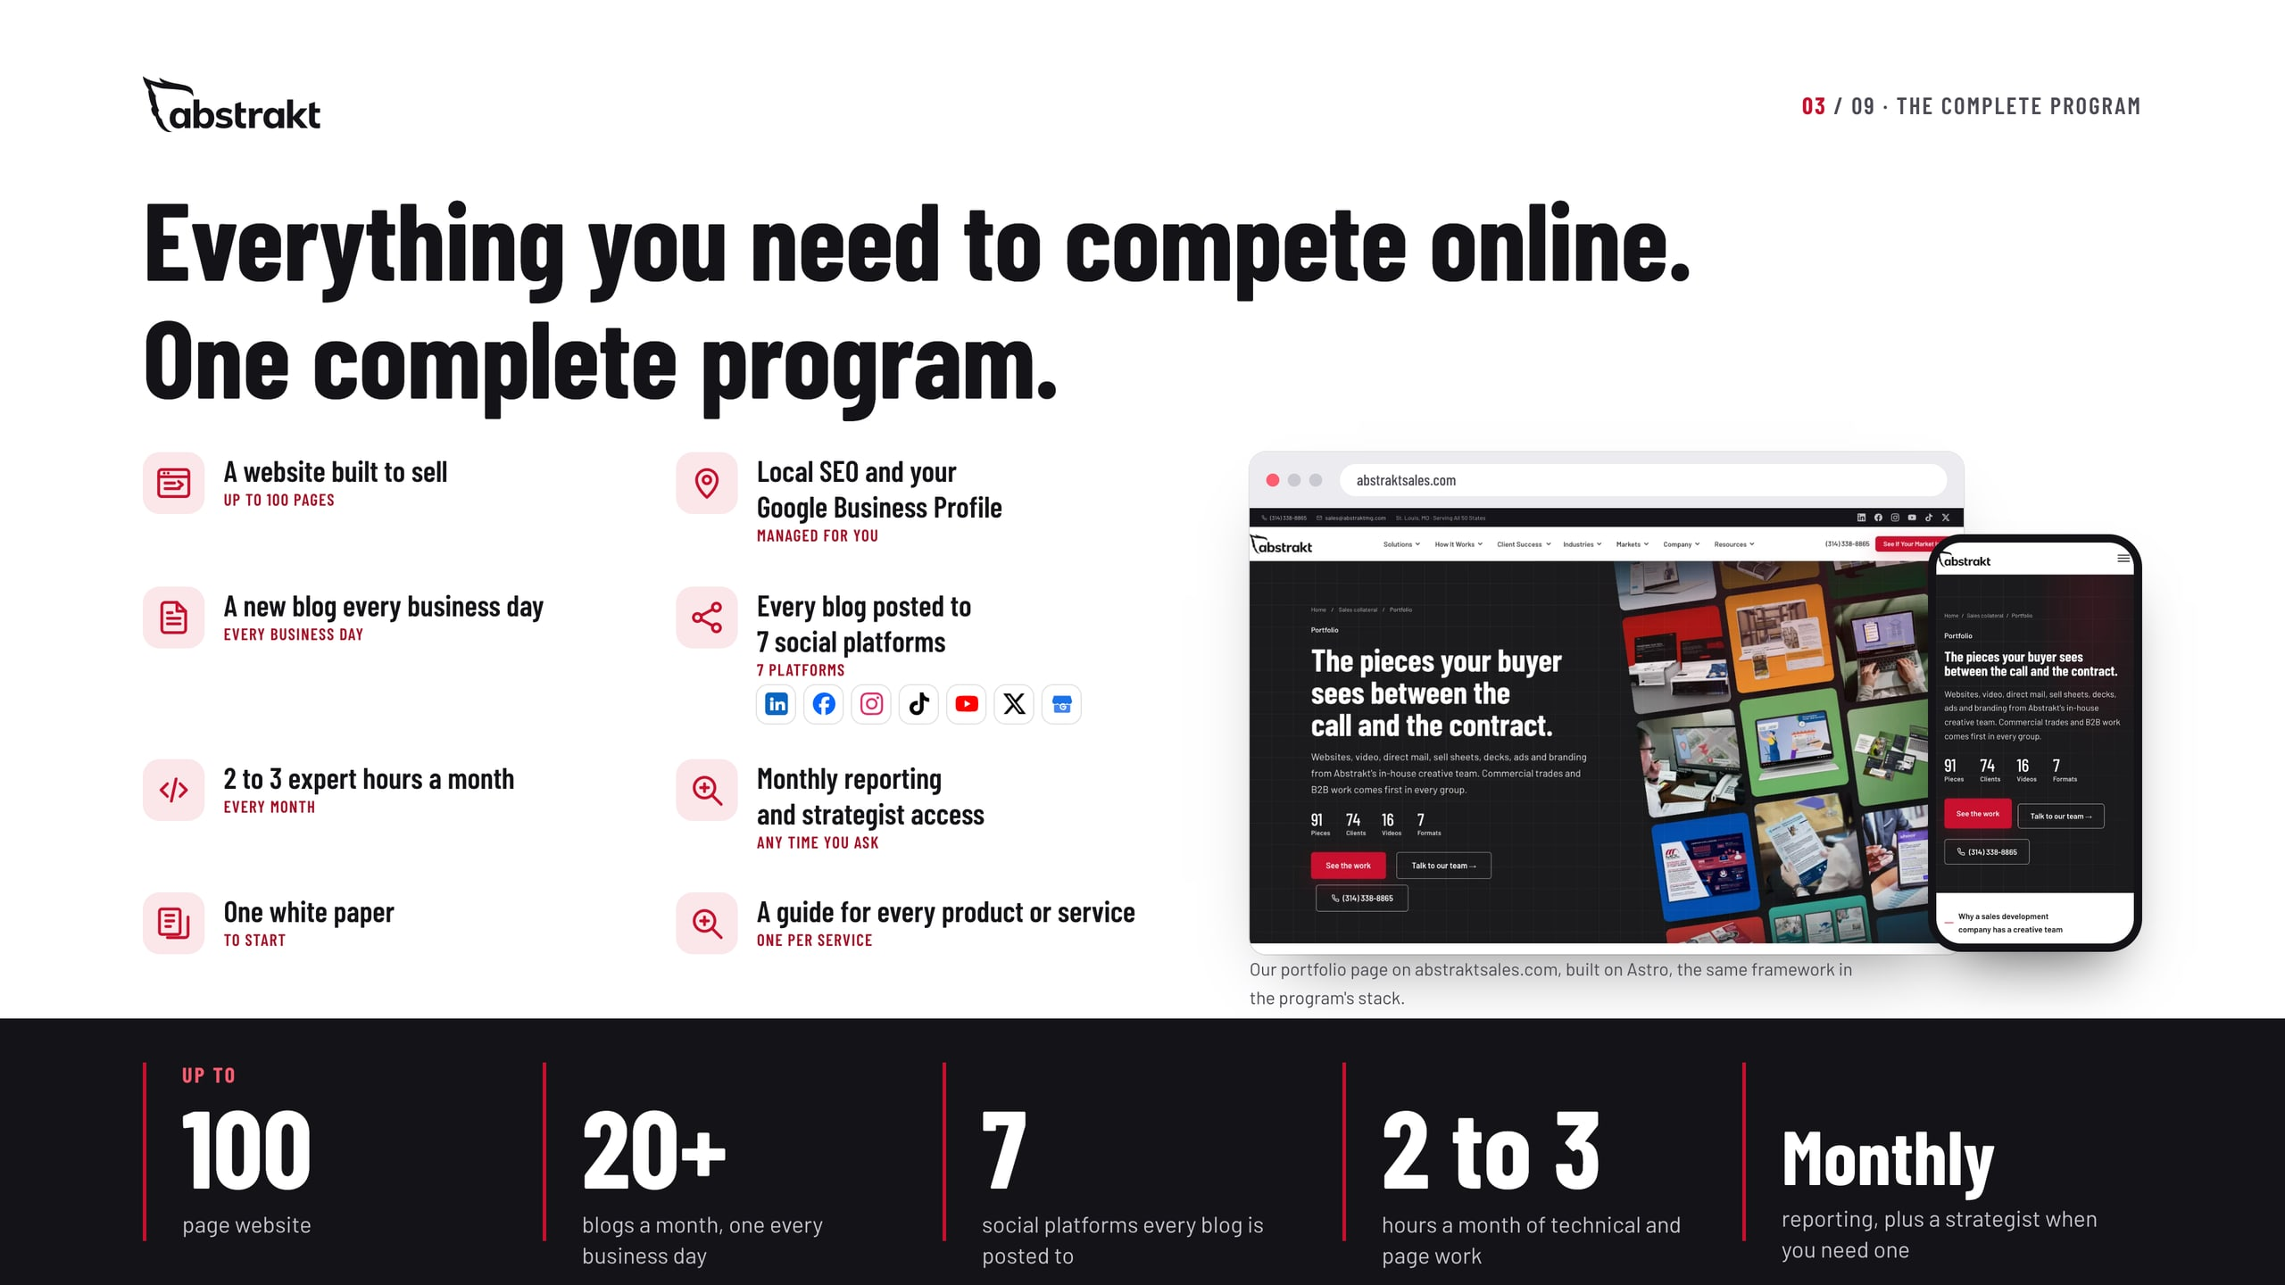
Notes:
This is the whole program on one page. From the starting price you get a website of up to 100 pages; local SEO and your Google Business Profile managed for you; a new blog every business day, published on your site and posted through all seven of your social channels; 2 to 3 expert hours a month for technical adjustments and fixes, page adjustments, or additional guides and white papers; monthly reporting and access to a strategist whenever you have questions; one white paper to start; and a guide for every product or service. The screens are our own site, built on the same framework the program uses. Scope depends on the size of the site, the number of markets and the content you need.

Slide 4
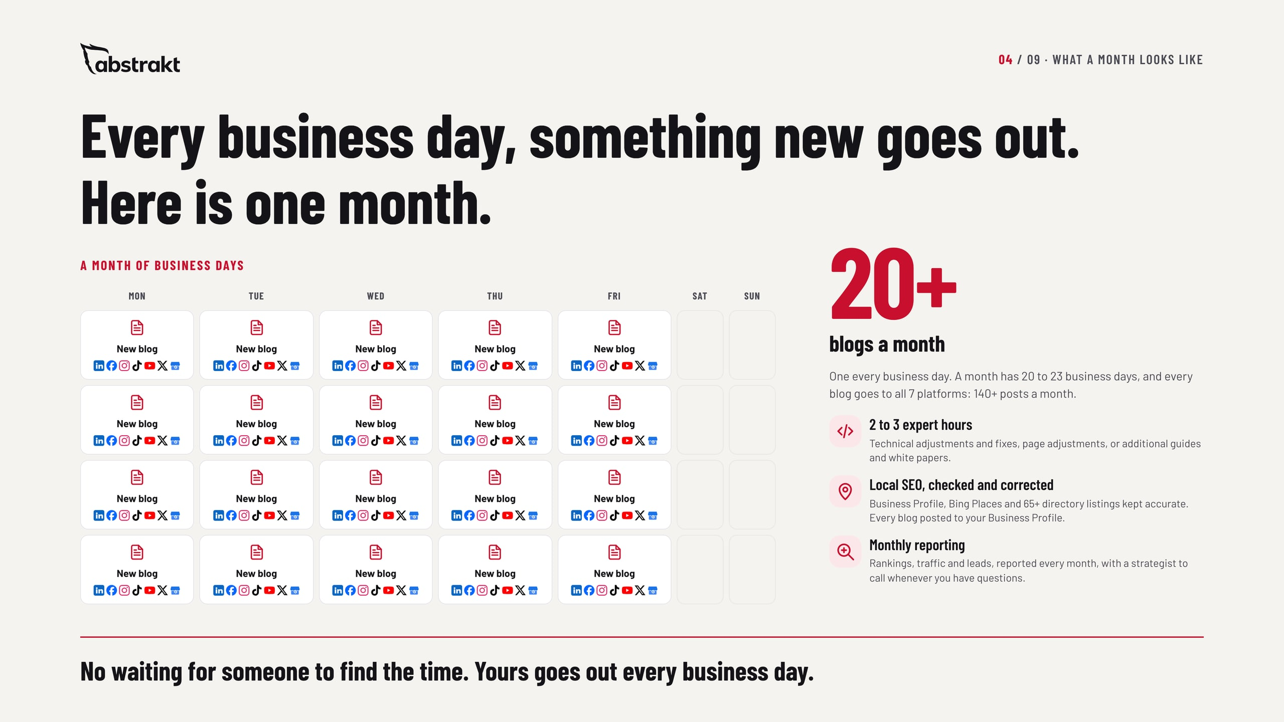
Notes:
This is what the monthly fee buys. We build the website in the first month; from month 2, every month looks like this. Every business day we write a blog for your buyers, publish it on your site and post it through all seven of your social channels: a month has 20 to 23 business days, so that is 20-plus blogs and 140-plus social posts a month. On top of that, 2 to 3 expert hours each month go to technical adjustments and fixes, page adjustments, or additional guides and white papers. Your Business Profile and listings are checked and corrected, and you get monthly reporting and a strategist whenever you have questions. Ask: how often does your company publish today?

Slide 5
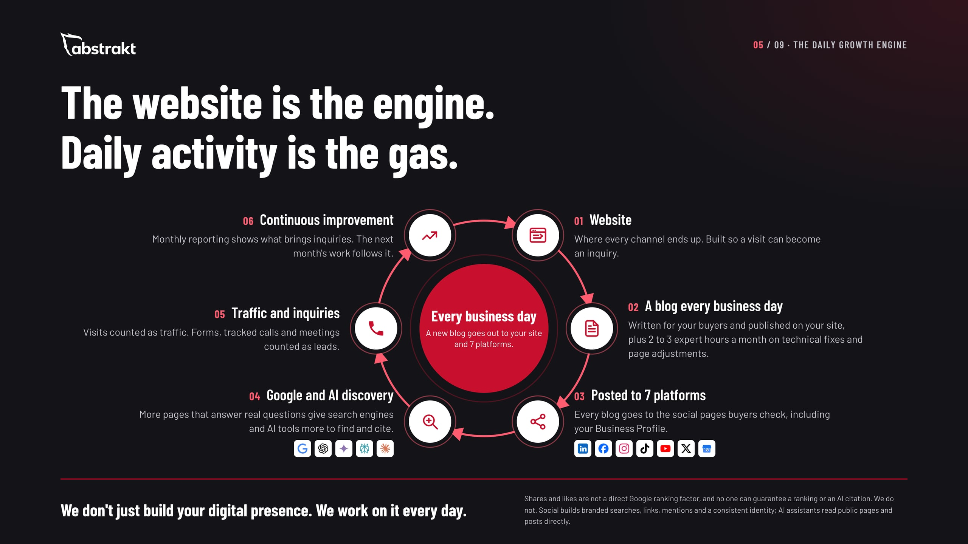
Notes:
This is why the price is monthly and not a one-time build. We build the website in the first month, and the daily work starts from there. The website is the engine, and daily activity is what moves it. Every business day a new blog is written, published and posted through all seven social channels, and more pages that answer real questions give Google and the AI assistants more to work with. Be precise here: social posts are not a direct ranking factor, and nobody can promise a ranking or an AI citation. What we control is whether your site gives them a clear, accurate, crawlable reason to show you. Search builds over months: initial results in one to three months, noticeable improvement in three to six, full results in six to twelve months or more.

Slide 6
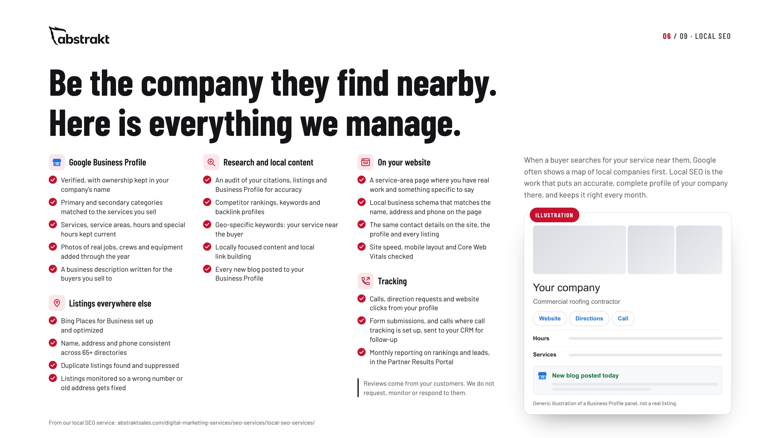
Notes:
Local is where a commercial buyer checks you out first, often right after a sales call. Walk through the checklist: the Business Profile verified in your name with the right categories, services, service areas, hours and job photos; Bing Places and 65-plus directories kept consistent, with duplicates suppressed; an audit, competitor and geo-keyword research, local content and local link building; service-area pages and local schema on your site; and tracking of calls, direction requests and clicks, reported monthly. Be clear that reviews come from their customers: we do not manage, request or respond to reviews.

Slide 7
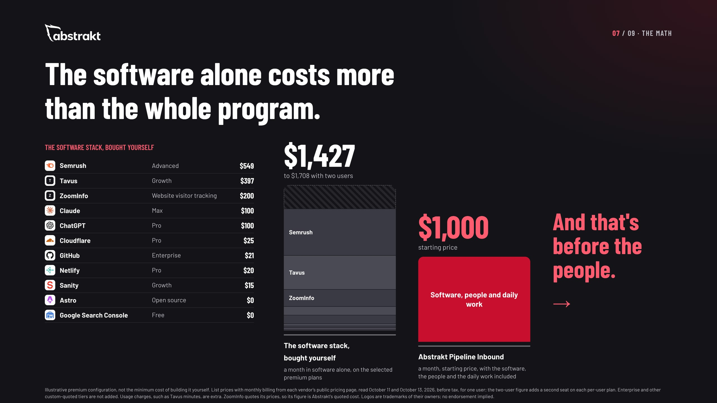
Notes:
This is the slide to slow down on. On the left is the software behind the program, priced from each vendor's own pricing page: $1,427 a month for one user on the plans we selected, $1,708 with two users. On the right is the whole program, starting at $1,000 a month. The software alone costs more than we charge for everything, and that is before anyone writes a blog, fixes a page or manages a listing. Be fair about it: this is an illustrative premium configuration, not the minimum anyone could spend, and enterprise tiers are not included. ZoomInfo's figure is our quoted cost.

Slide 8
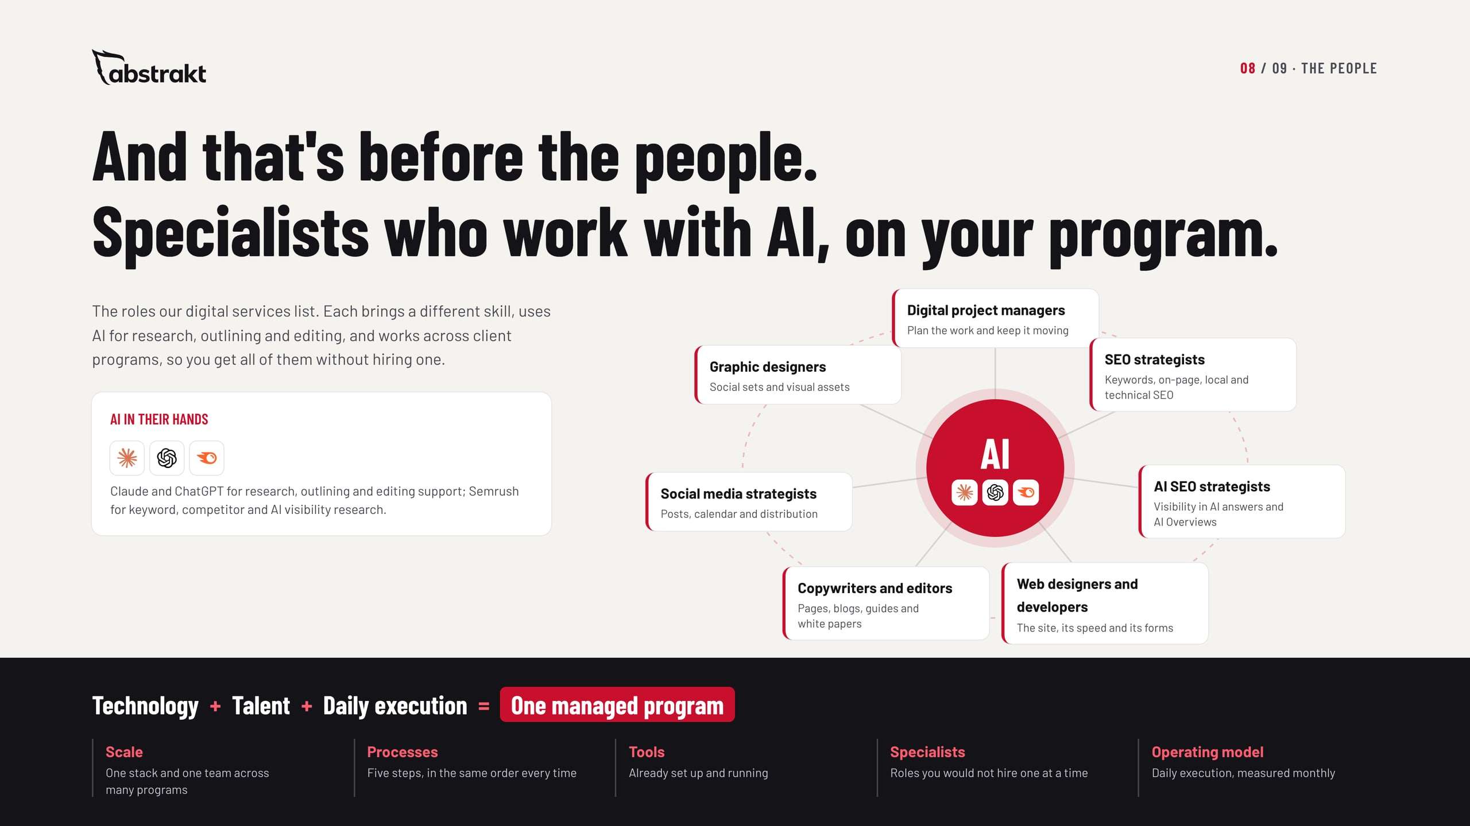
Notes:
Software does nothing on its own. On our side, people with different skill sets work with AI every day to make the program succeed: project managers, SEO and AI SEO strategists, web designers and developers, copywriters and editors, social media strategists and graphic designers. They work across client programs, so you get the whole bench without hiring a single role. That is the operating model: technology, talent and daily execution, as one managed program.

Slide 9
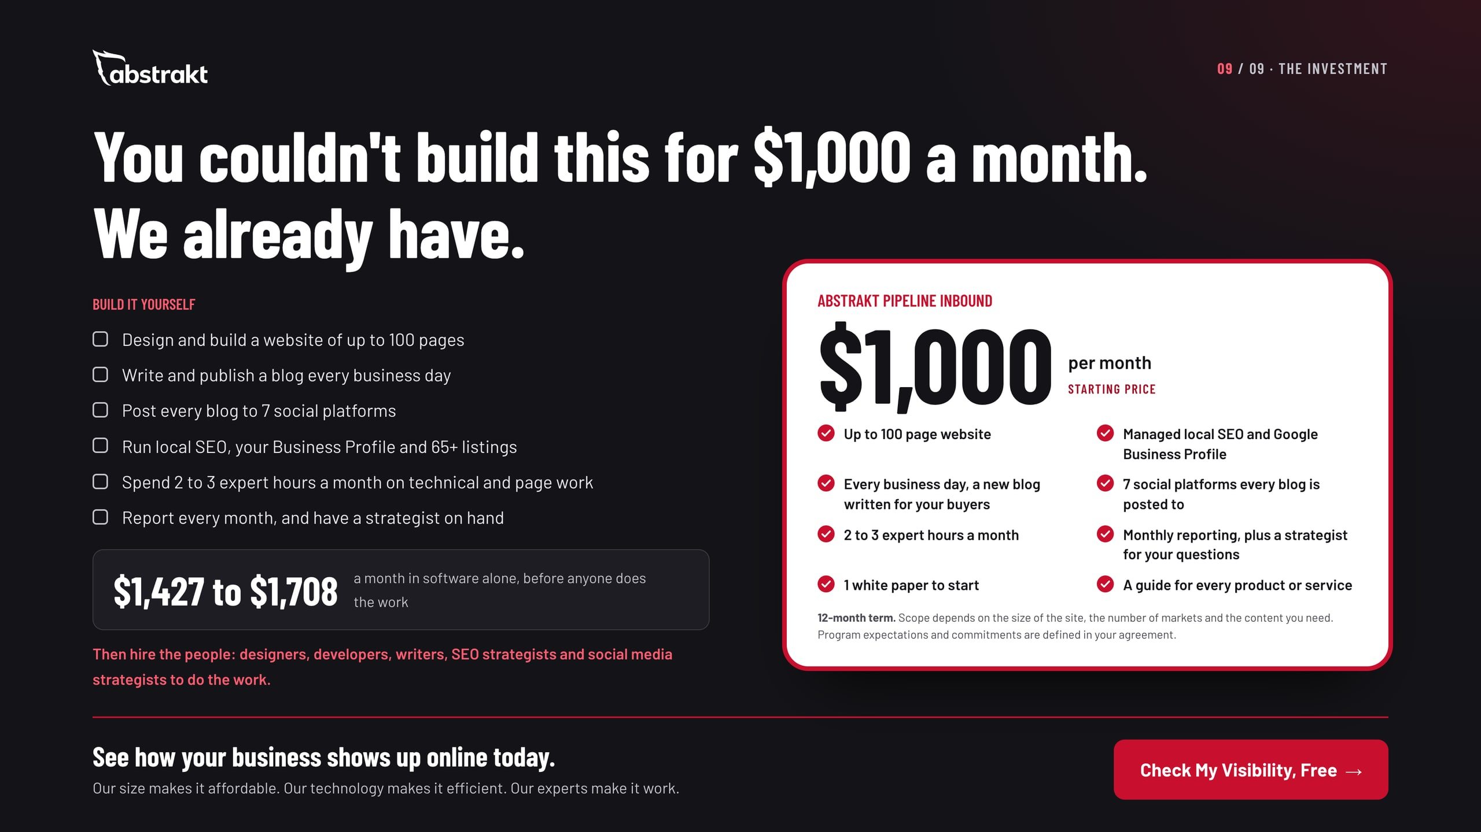
Notes:
Bring it together. On the left is what it takes to do this yourself: the software alone is $1,427 to $1,708 a month, before anyone designs a page, writes a blog or manages a listing. On the right is the program, starting at $1,000 a month on a 12-month term, with every inclusion listed. Program expectations and commitments are set out in the agreement. Close with the next step: a visibility review of their site, Business Profile, listings, social pages and what AI tools say about them, then a practical plan.

