Slide 1
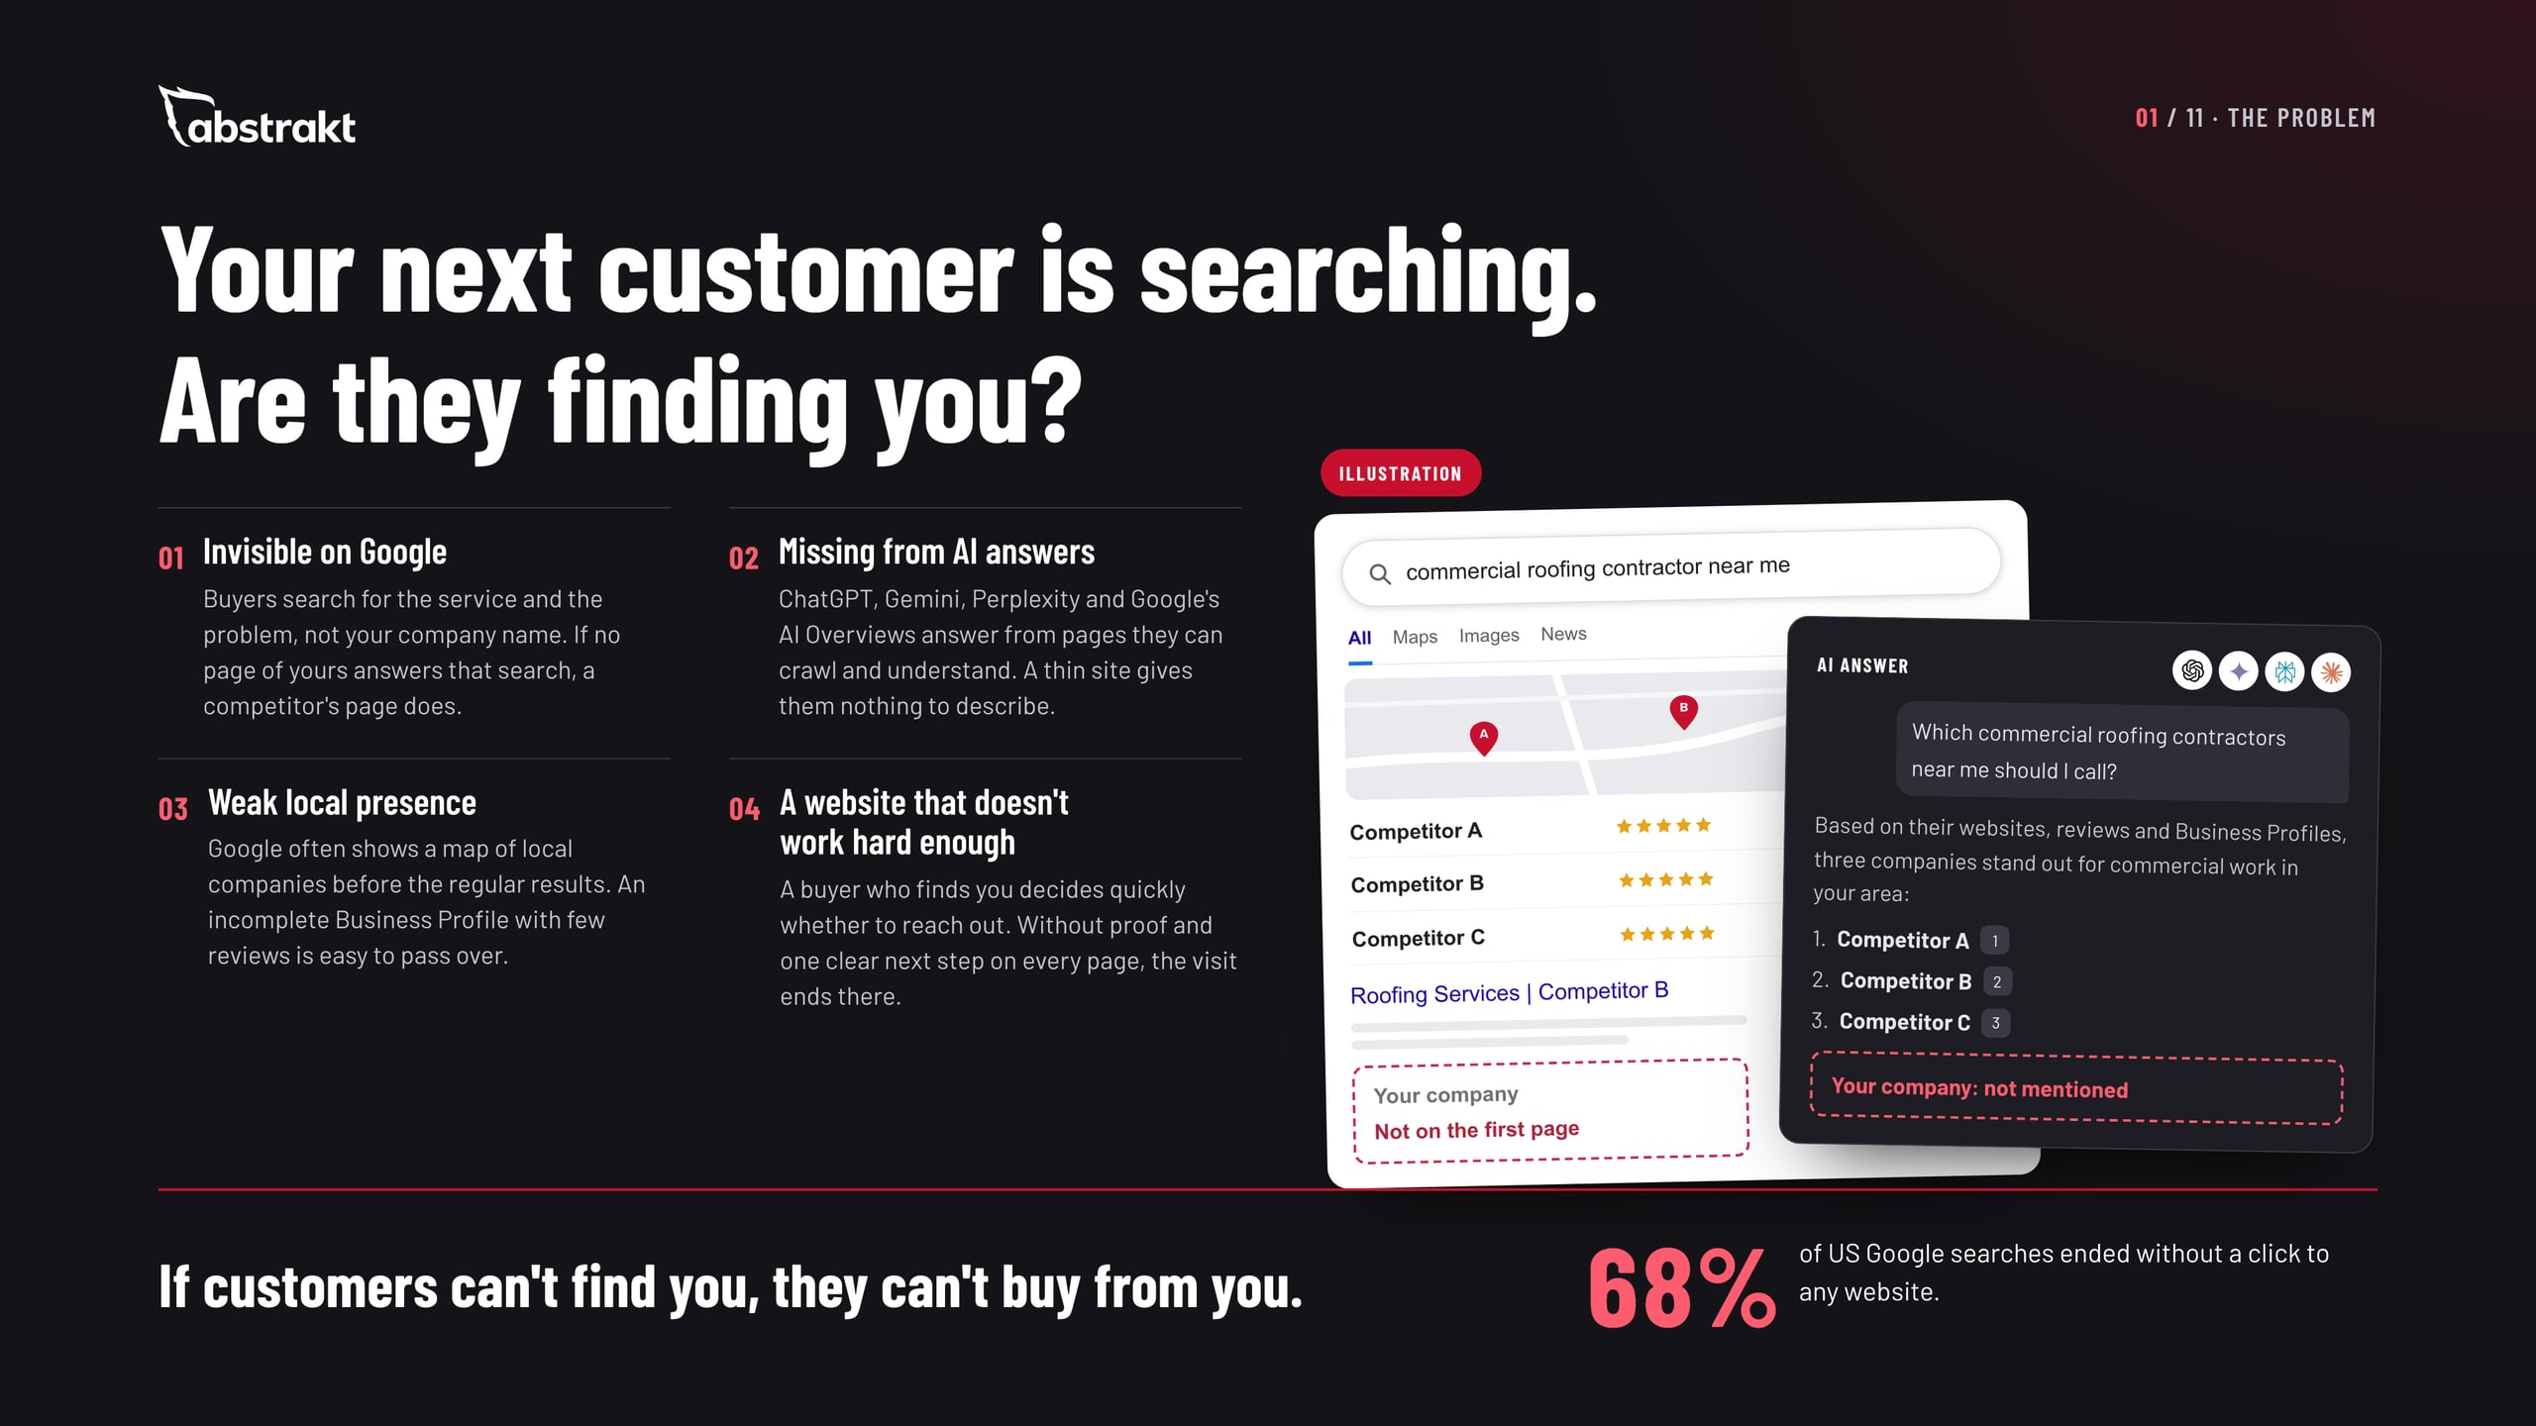
Notes:
Open with the buyer, not with us. Every commercial buyer checks you out online before they reach out or agree to an appointment, and more of them now ask an AI assistant first. Walk through the four places a company loses that buyer: it doesn't show up for the search, the AI answer doesn't mention it, the map shows competitors, or the website gives no reason to call. The 68% figure is SparkToro's, from Similarweb data on US searches, January to April 2026: most searches end on the results page, so what shows there matters. Ask: when you search for your own service in your area, who comes up?

Slide 2
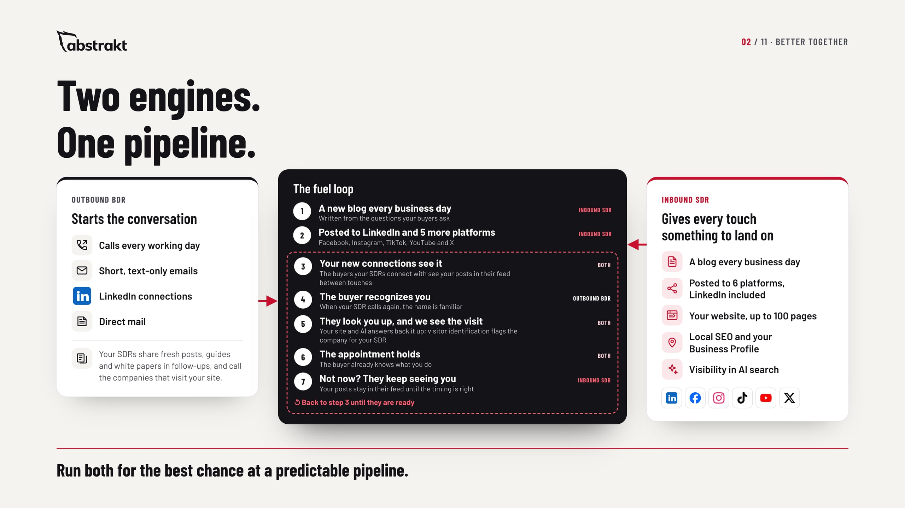
Notes:
This is the slide for anyone running outbound, or thinking about it. Two engines. On the left, Outbound BDR starts the conversation: calls every working day, short emails, LinkedIn connections and direct mail. On the right, Inbound SDR gives every one of those touches something to land on: a blog every business day posted to six platforms including LinkedIn, the website, local SEO and visibility in AI search. In the middle is the fuel loop. Every business day a new blog goes out and is posted to LinkedIn and six more platforms. The buyers your SDRs connect with see those posts in their feed between touches, so when the SDR calls again the name is familiar. When they look you up, your site, Business Profile and AI answers back it up, and because we run the website, visitor identification shows us the company, so your SDR can call while the interest is fresh. The appointment holds. The "not now" buyers keep seeing your posts until the timing is right. And your SDRs always have something new to send: fresh posts, guides and white papers. No promises on numbers; this is simply how the two work together. Ask: when your SDR connects with a buyer on LinkedIn, what do they see in their feed the next day?

Slide 3
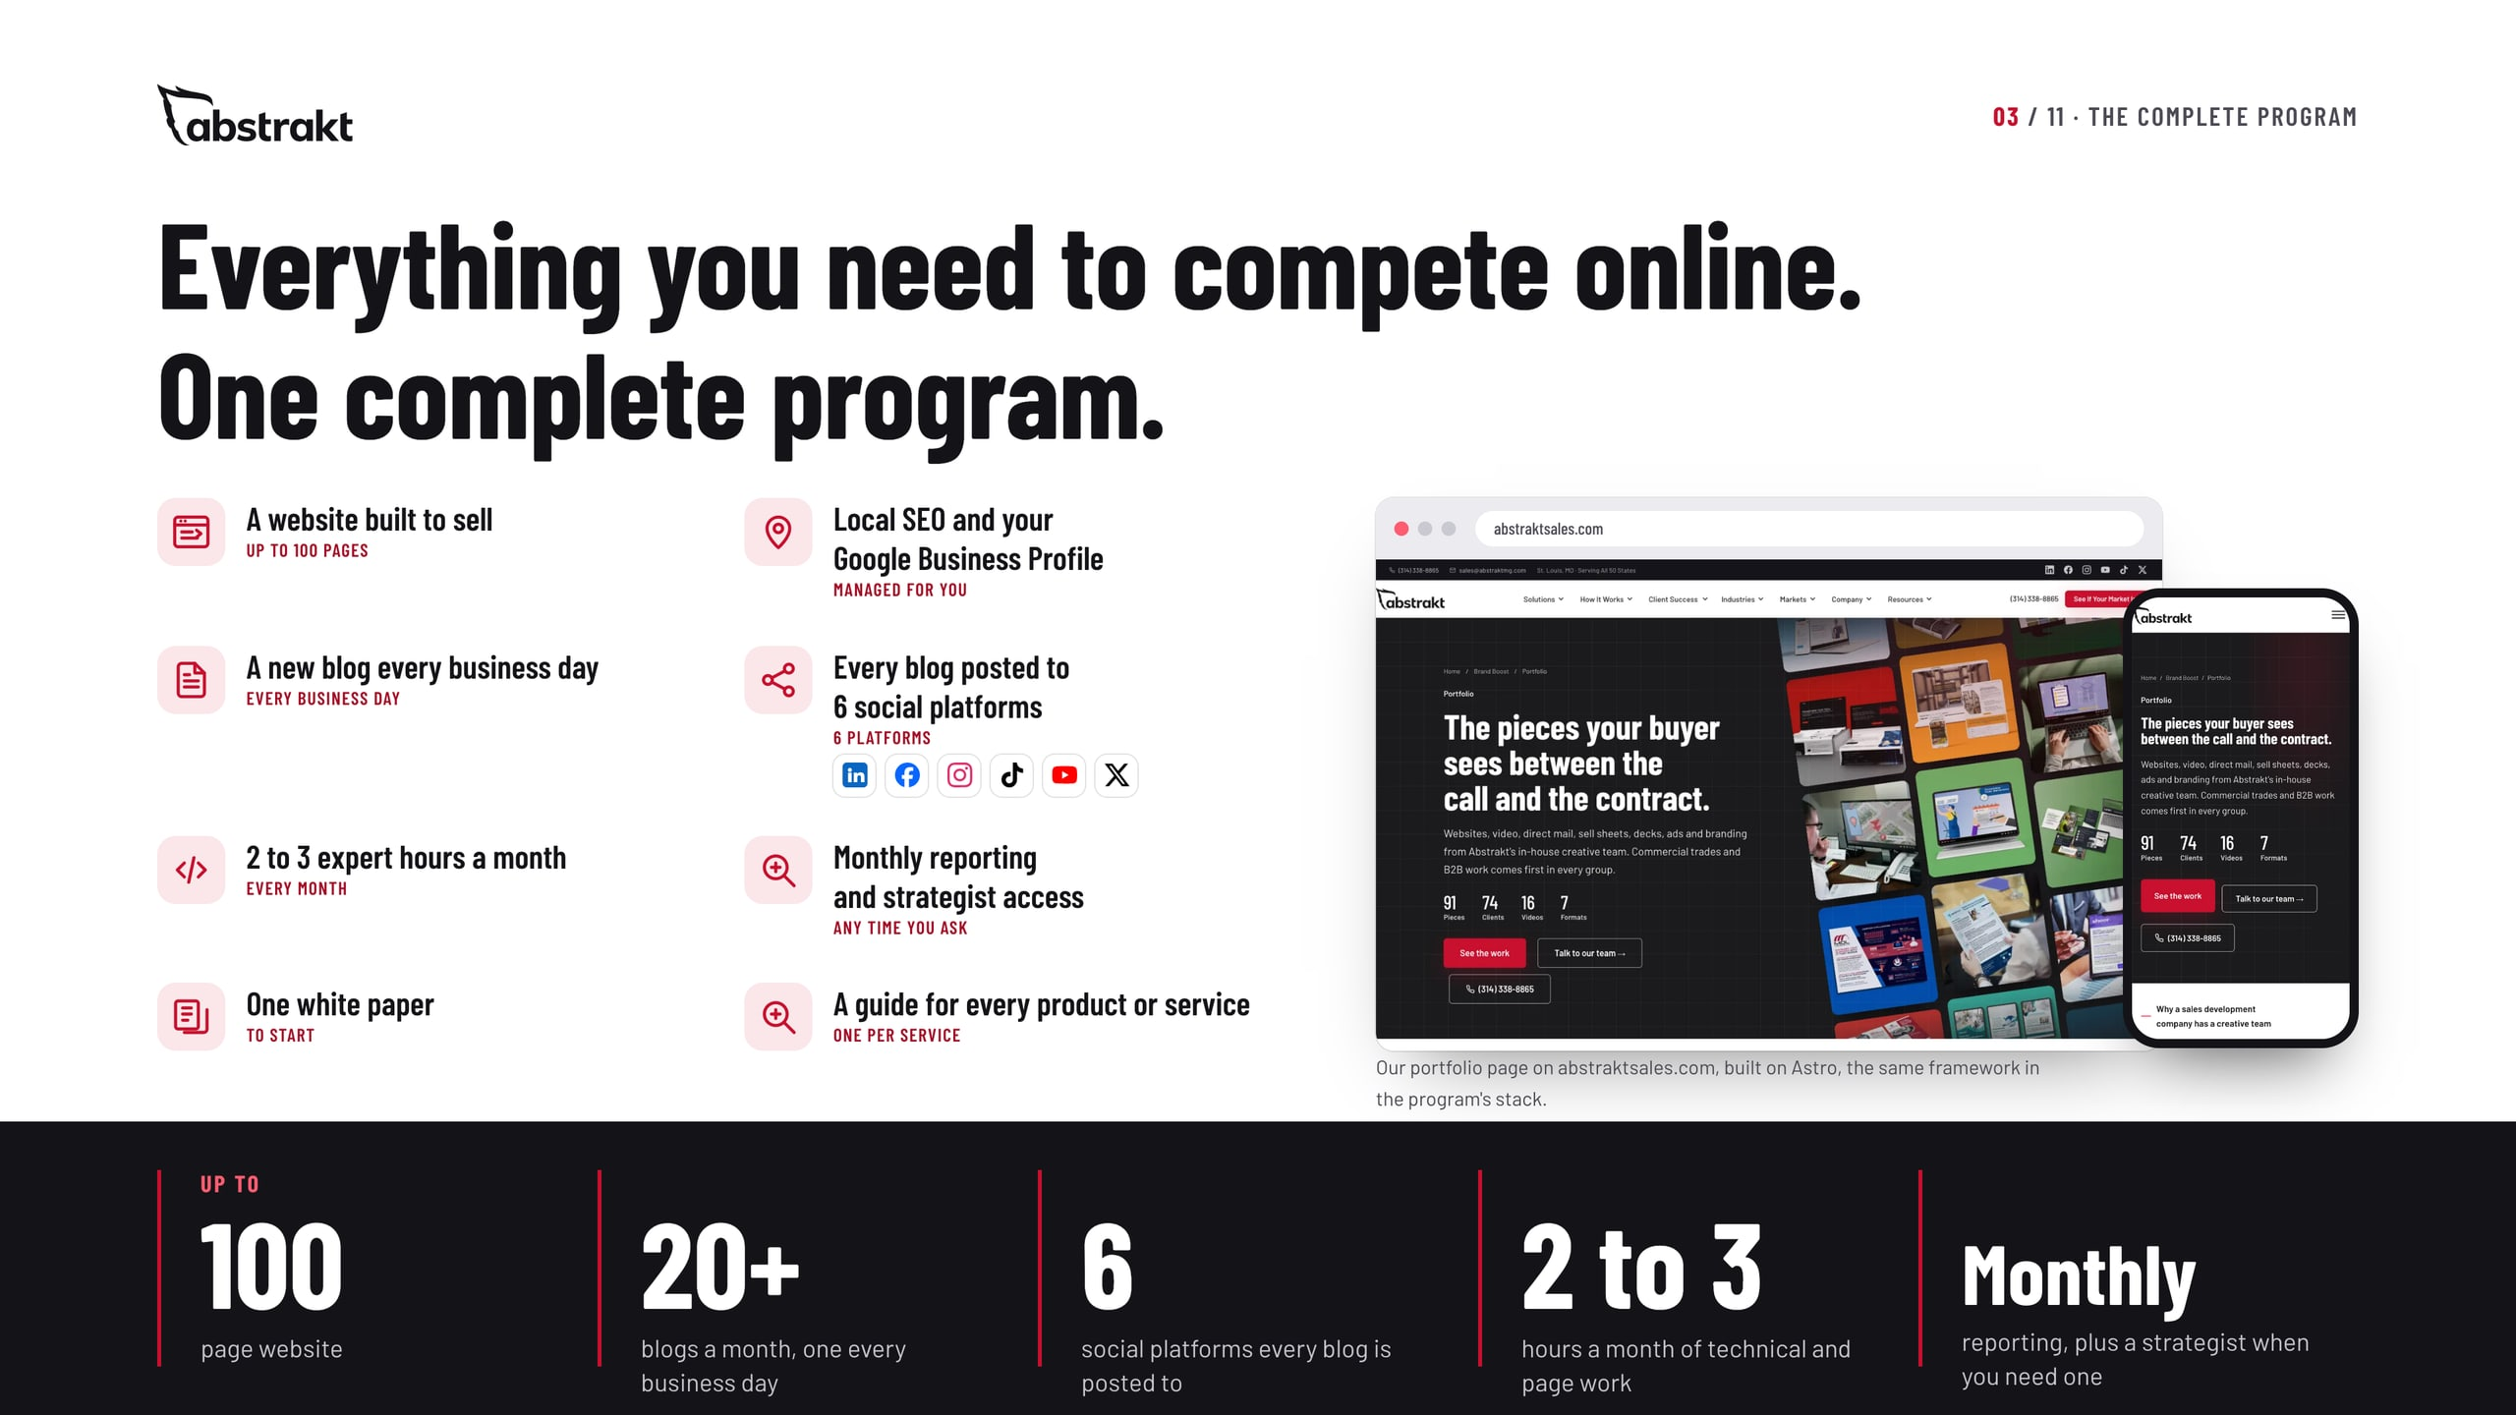
Notes:
This is the whole program on one page. From the starting price you get a website of up to 100 pages; local SEO and your Google Business Profile managed for you; a new blog every business day, published on your site and posted through all six of your social channels; 2 to 3 expert hours a month for technical adjustments and fixes, page adjustments, or additional guides and white papers; monthly reporting and access to a strategist whenever you have questions; one white paper to start; and a guide for every product or service. The screens are our own site, built on the same framework the program uses. Scope depends on the size of the site, the number of markets and the content you need.

Slide 4
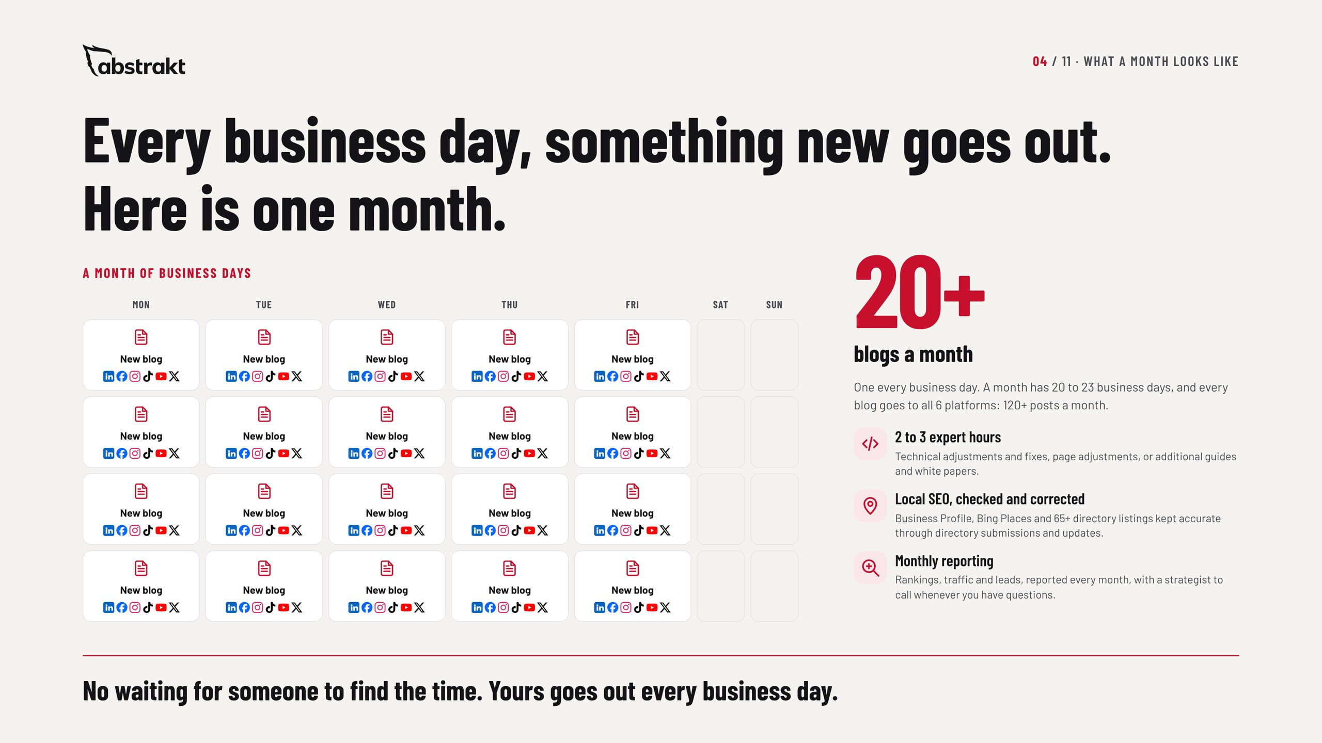
Notes:
This is what the monthly fee buys. We build the website in the first month; from month 2, every month looks like this. Every business day we write a blog for your buyers, publish it on your site and post it through all six of your social channels: a month has 20 to 23 business days, so that is 20-plus blogs and 120-plus social posts a month. On top of that, 2 to 3 expert hours each month go to technical adjustments and fixes, page adjustments, or additional guides and white papers. Your Business Profile and listings are checked and corrected, and you get monthly reporting and a strategist whenever you have questions. Ask: how often does your company publish today?

Slide 5
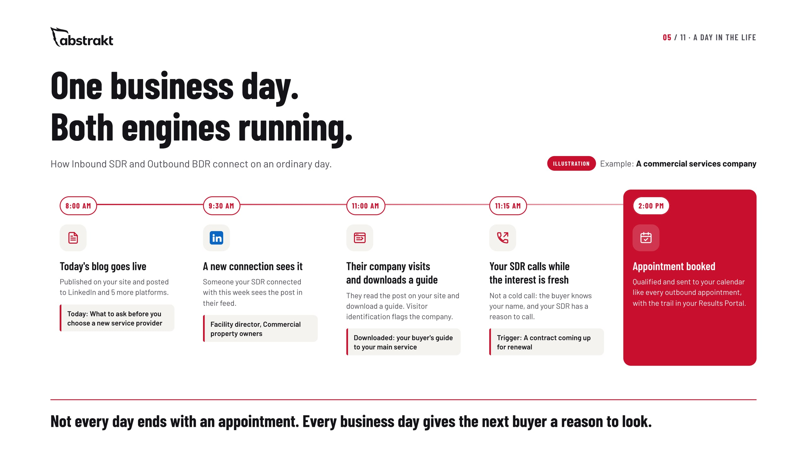
Notes:
Make the two engines concrete with one ordinary day. In the morning a new blog goes live on the client's site and is posted to LinkedIn and five more platforms. A buyer the SDR connected with on LinkedIn sees it in their feed, visits the site and downloads a guide; because we run the website, visitor identification flags the company and the download shows someone raised a hand. The SDR calls while the interest is fresh, with a reason to call, and books a qualified appointment that goes to the client's calendar and the Results Portal. Say clearly that the times and names are an illustration, not a promise of timing or results. Ask: what happens today when a buyer downloads something from your website?

Slide 6
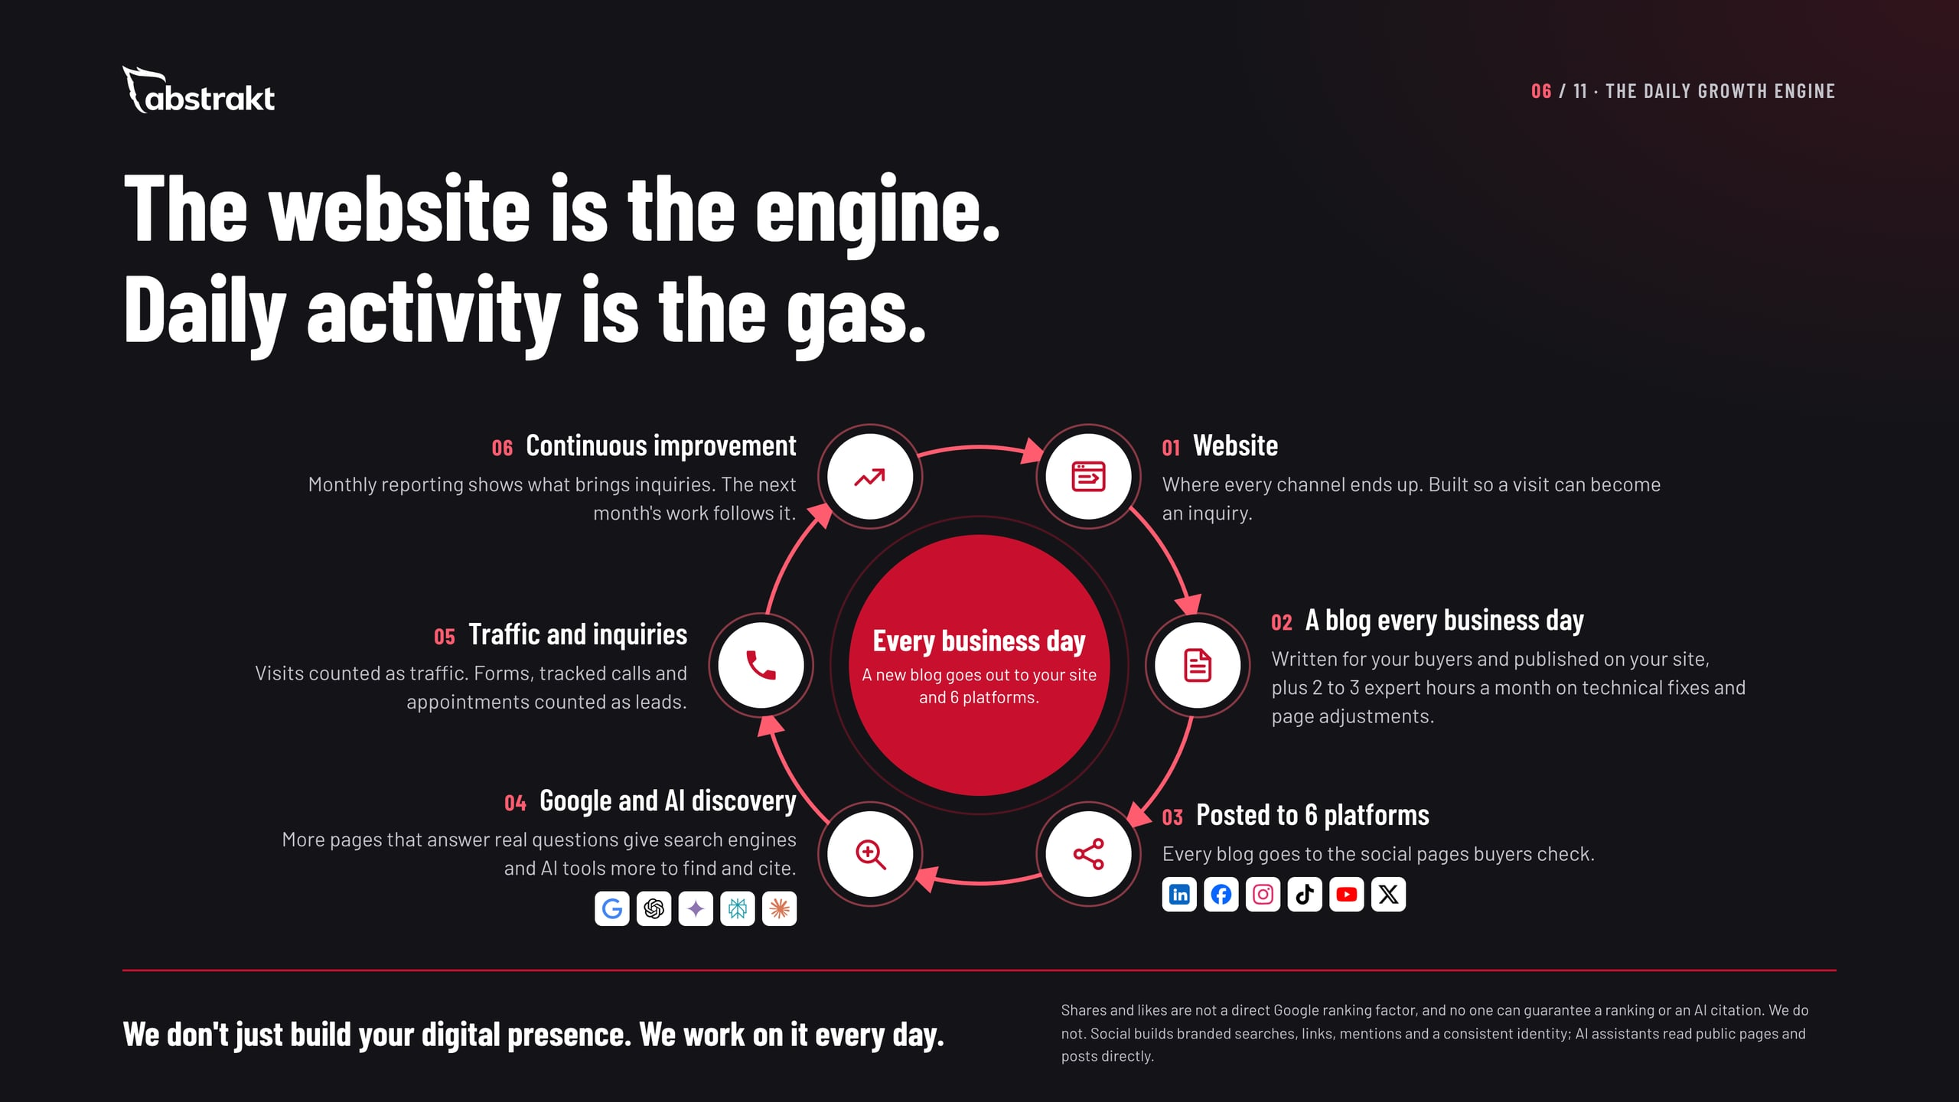
Notes:
This is why the price is monthly and not a one-time build. We build the website in the first month, and the daily work starts from there. The website is the engine, and daily activity is what moves it. Every business day a new blog is written, published and posted through all six social channels, and more pages that answer real questions give Google and the AI assistants more to work with. Be precise here: social posts are not a direct ranking factor, and nobody can promise a ranking or an AI citation. What we control is whether your site gives them a clear, accurate, crawlable reason to show you. Search builds over months: initial results in one to three months, noticeable improvement in three to six, full results in six to twelve months or more.

Slide 7
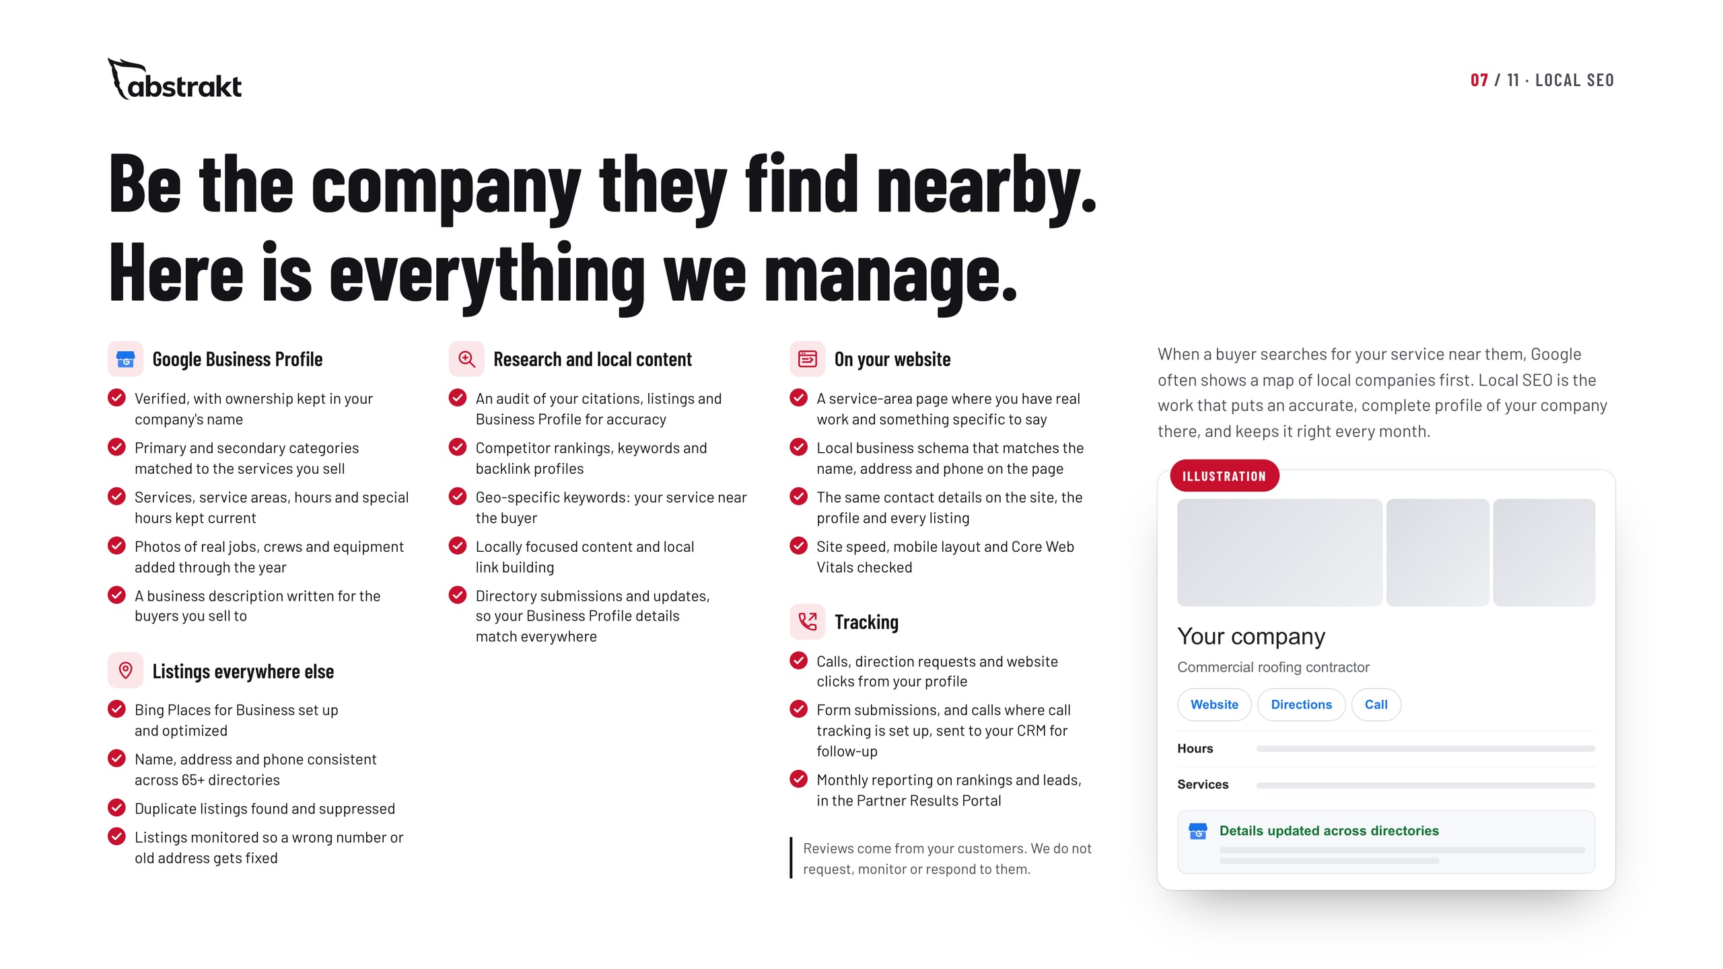
Notes:
Local is where a commercial buyer checks you out first, often right after a sales call. Walk through the checklist: the Business Profile verified in your name with the right categories, services, service areas, hours and job photos; Bing Places and 65-plus directories kept consistent, with duplicates suppressed; an audit, competitor and geo-keyword research, local content and local link building; service-area pages and local schema on your site; and tracking of calls, direction requests and clicks, reported monthly. Be clear that reviews come from their customers: we do not manage, request or respond to reviews.

Slide 8
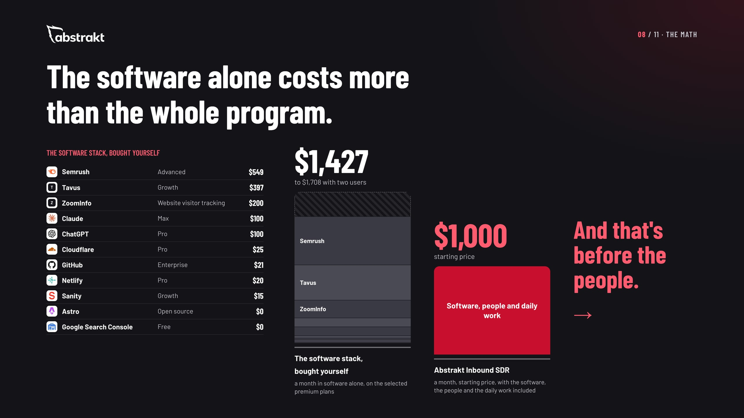
Notes:
This is the slide to slow down on. On the left is the software behind the program, priced from each vendor's own pricing page: $1,427 a month for one user on the plans we selected, $1,708 with two users. On the right is the whole program, starting at $1,000 a month. The software alone costs more than we charge for everything, and that is before anyone writes a blog, fixes a page or manages a listing. Be fair about it: this is an illustrative premium configuration, not the minimum anyone could spend, and enterprise tiers are not included. ZoomInfo's figure is our quoted cost.

Slide 9
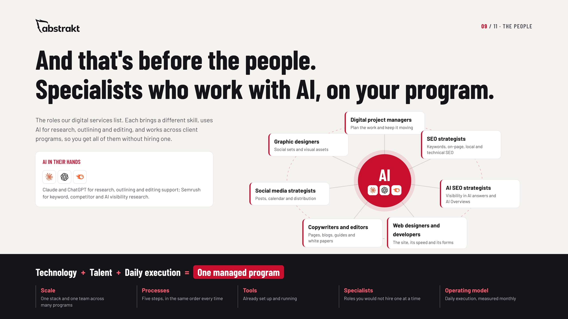
Notes:
Software does nothing on its own. On our side, people with different skill sets work with AI every day to make the program succeed: project managers, SEO and AI SEO strategists, web designers and developers, copywriters and editors, social media strategists and graphic designers. They work across client programs, so you get the whole bench without hiring a single role. That is the operating model: technology, talent and daily execution, as one managed program.

Slide 10
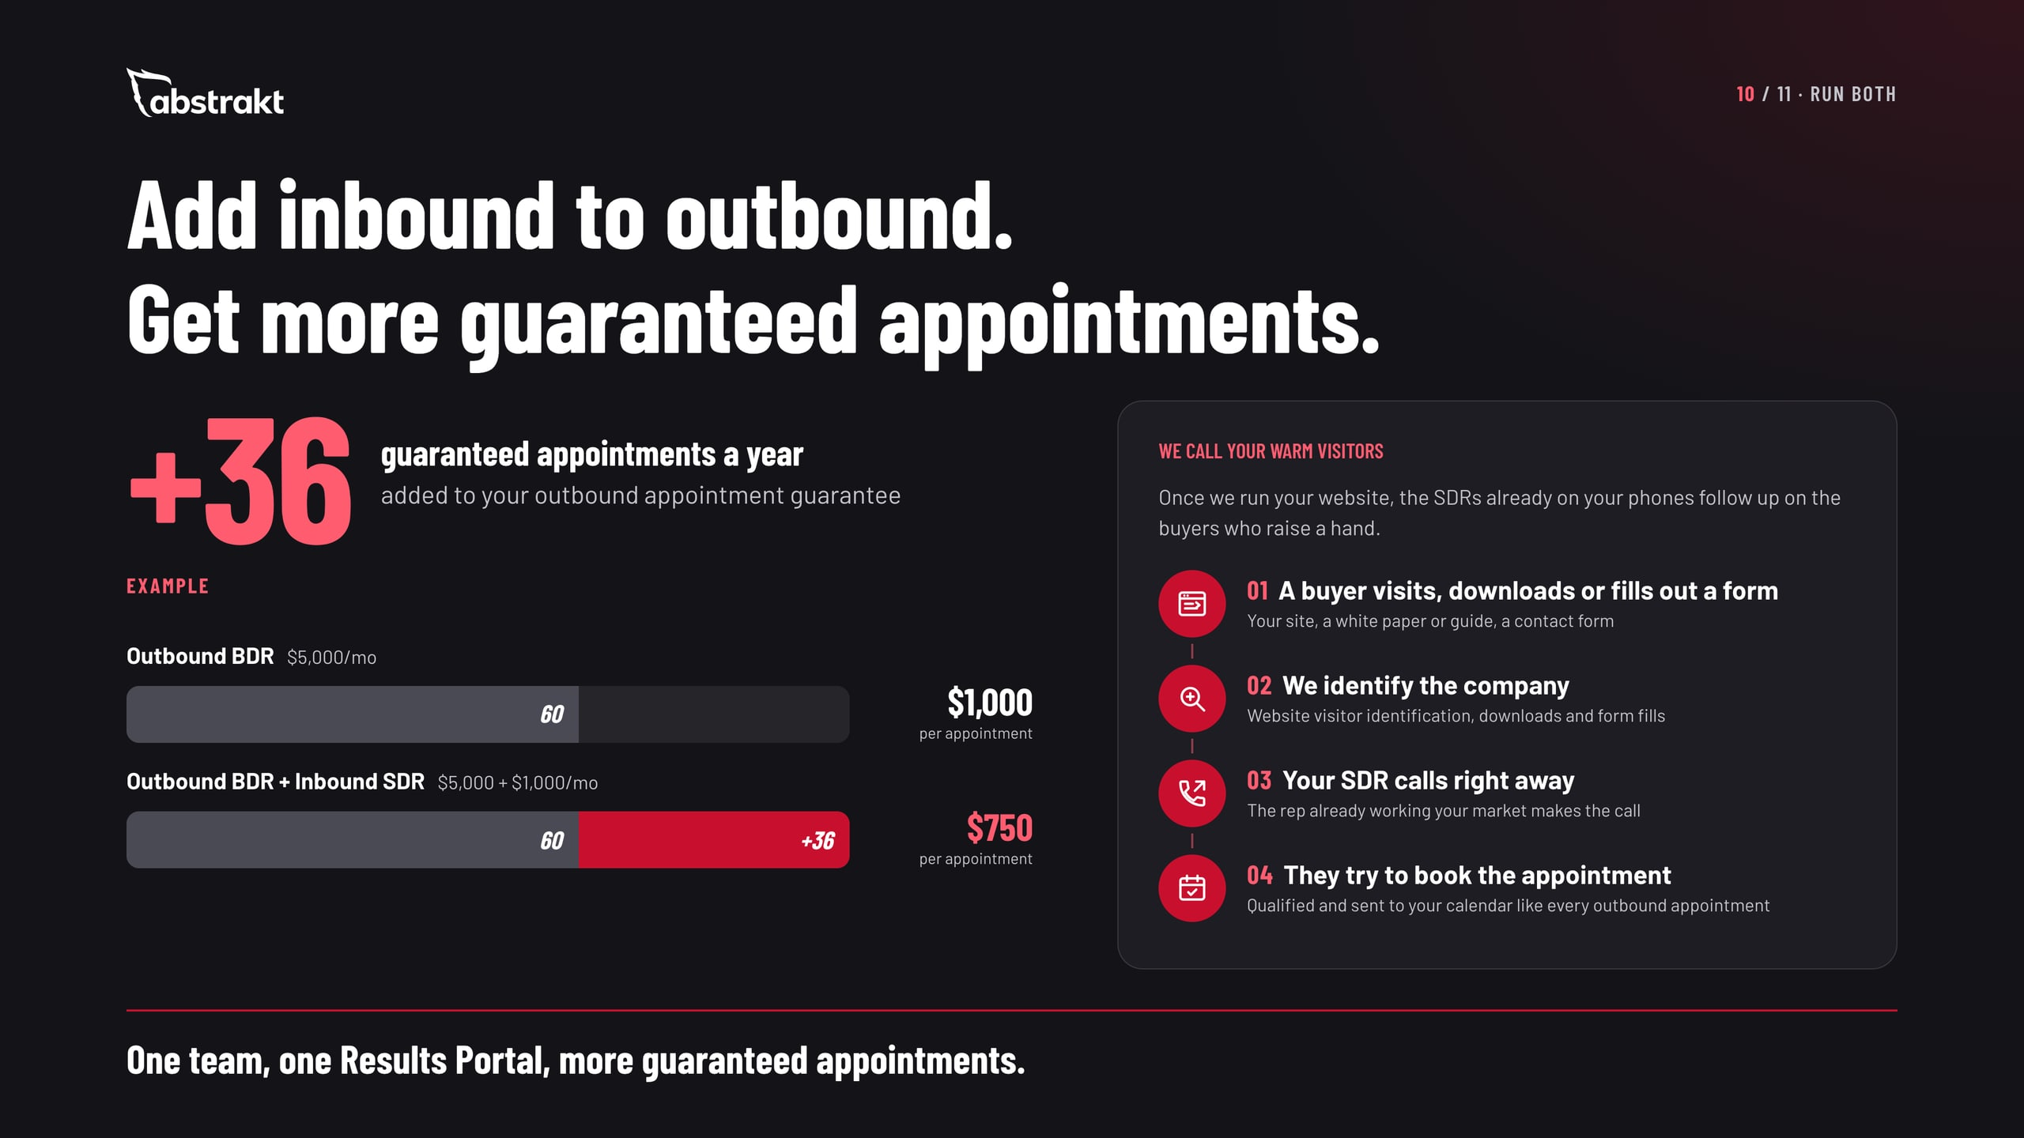
Notes:
If they run outbound, this is the offer. Add Inbound SDR to Outbound BDR and we add 36 guaranteed appointments a year to the outbound appointment guarantee. Use the example on the slide and say it is an example: with a 60-appointment annual guarantee on Outbound BDR from $5,000 a month, adding Inbound SDR from $1,000 a month takes it to 96, and the cost per guaranteed appointment goes from $1,000 to $750 at the starting prices. Their own guarantee is defined in their agreement. Then the second payoff: once we run the website, we see which companies visit, who downloads a white paper or guide and who fills out a form, and the SDRs already on their phones call them right away to try to book an appointment. No promises on response or results; this is how the follow-up works. Ask: who calls the companies that visit your website today?

Slide 11
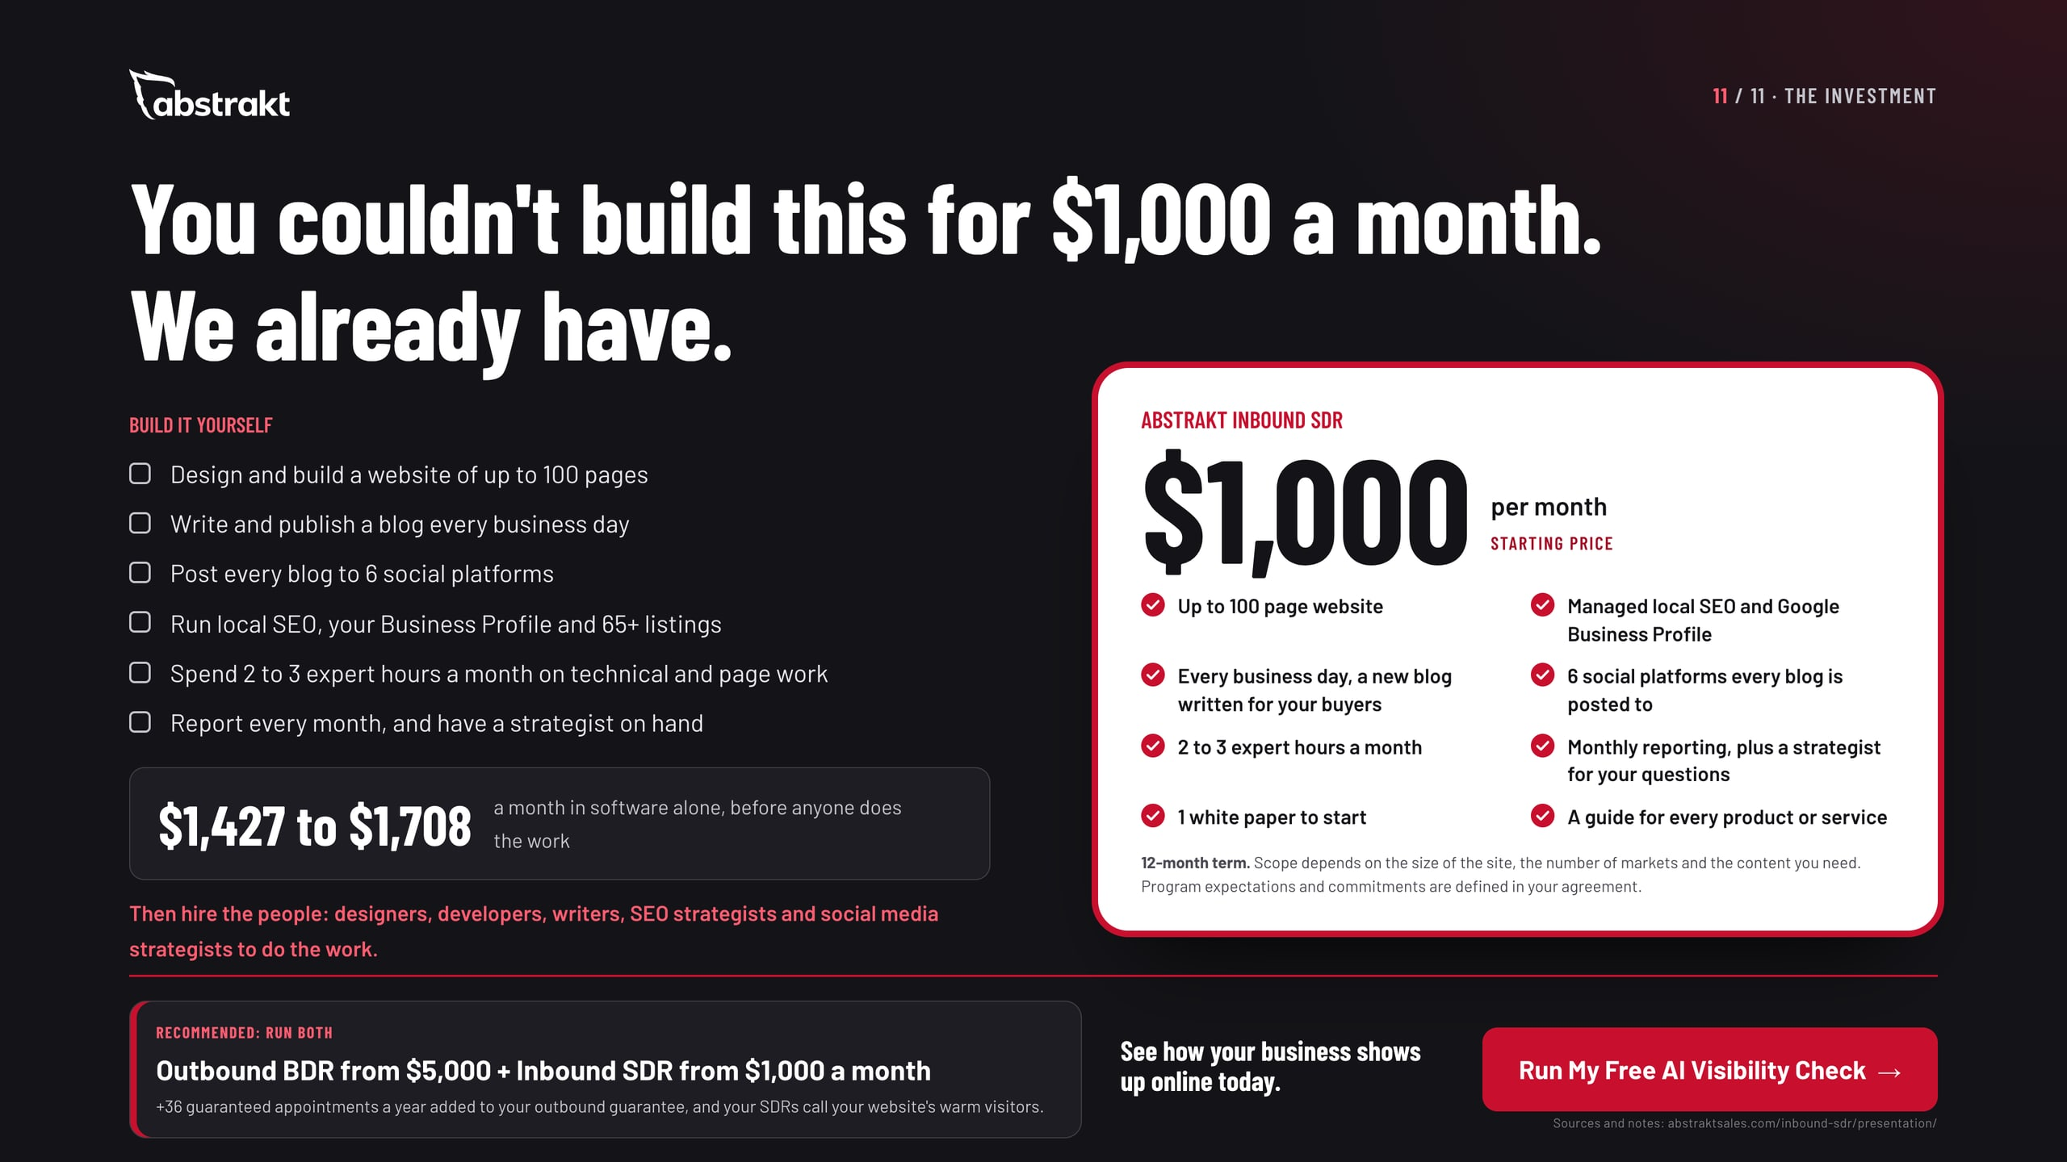
Notes:
Bring it together. On the left is what it takes to do this yourself: the software alone is $1,427 to $1,708 a month, before anyone designs a page, writes a blog or manages a listing. On the right is the program, starting at $1,000 a month on a 12-month term, with every inclusion listed. Program expectations and commitments are set out in the agreement. If they run outbound, or should, recommend both: Outbound BDR starts the conversation and Inbound SDR keeps it going, run by one team with every lead in one Results Portal. The starting prices are on the slide. Close with the next step: a visibility review of their site, Business Profile, listings, social pages and what AI tools say about them, then a practical plan.

