Slide 1
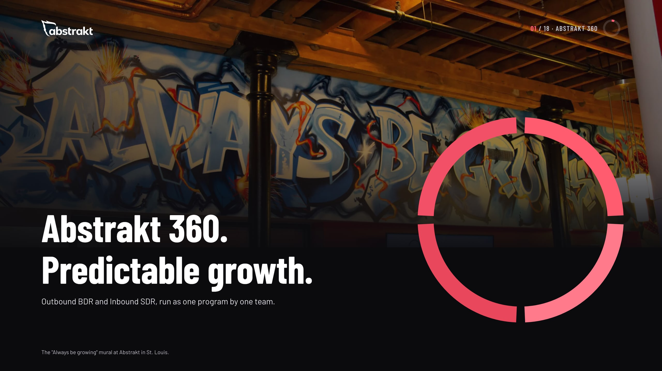
Notes:
Open with the promise: predictable growth. Abstrakt 360 is Outbound BDR and Inbound SDR run as one program by one team. Everything that follows is how that promise is kept.

Slide 2
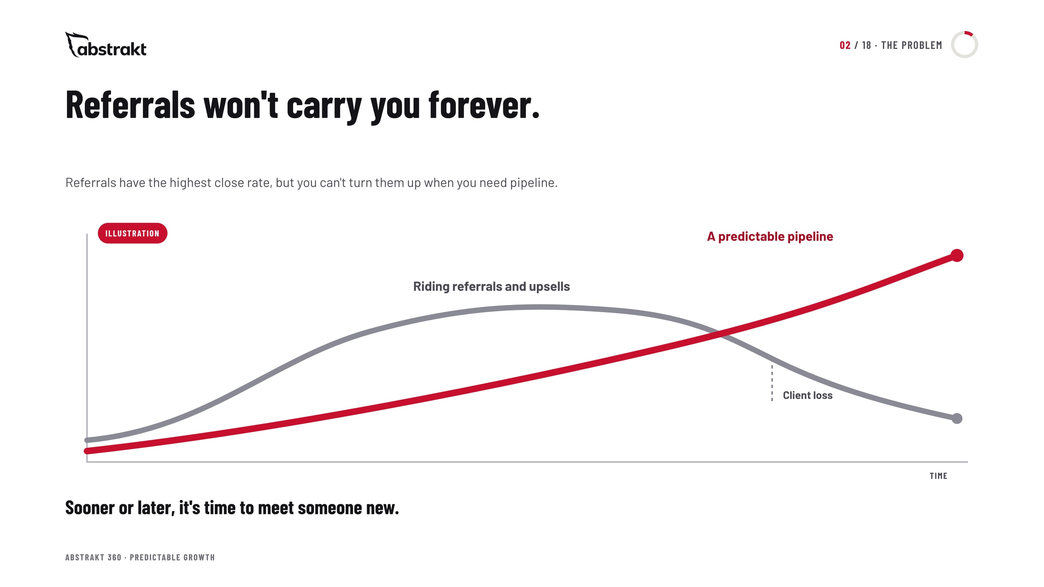
Notes:
Referrals and upsells carry a company for a while. Referrals have the highest close rate, but you can't turn them up when you need pipeline, and every business loses clients over time. The chart is an illustration, not data: growth that rides referrals flattens and dips with client loss; growth from a pipeline you build on purpose keeps climbing.

Slide 3
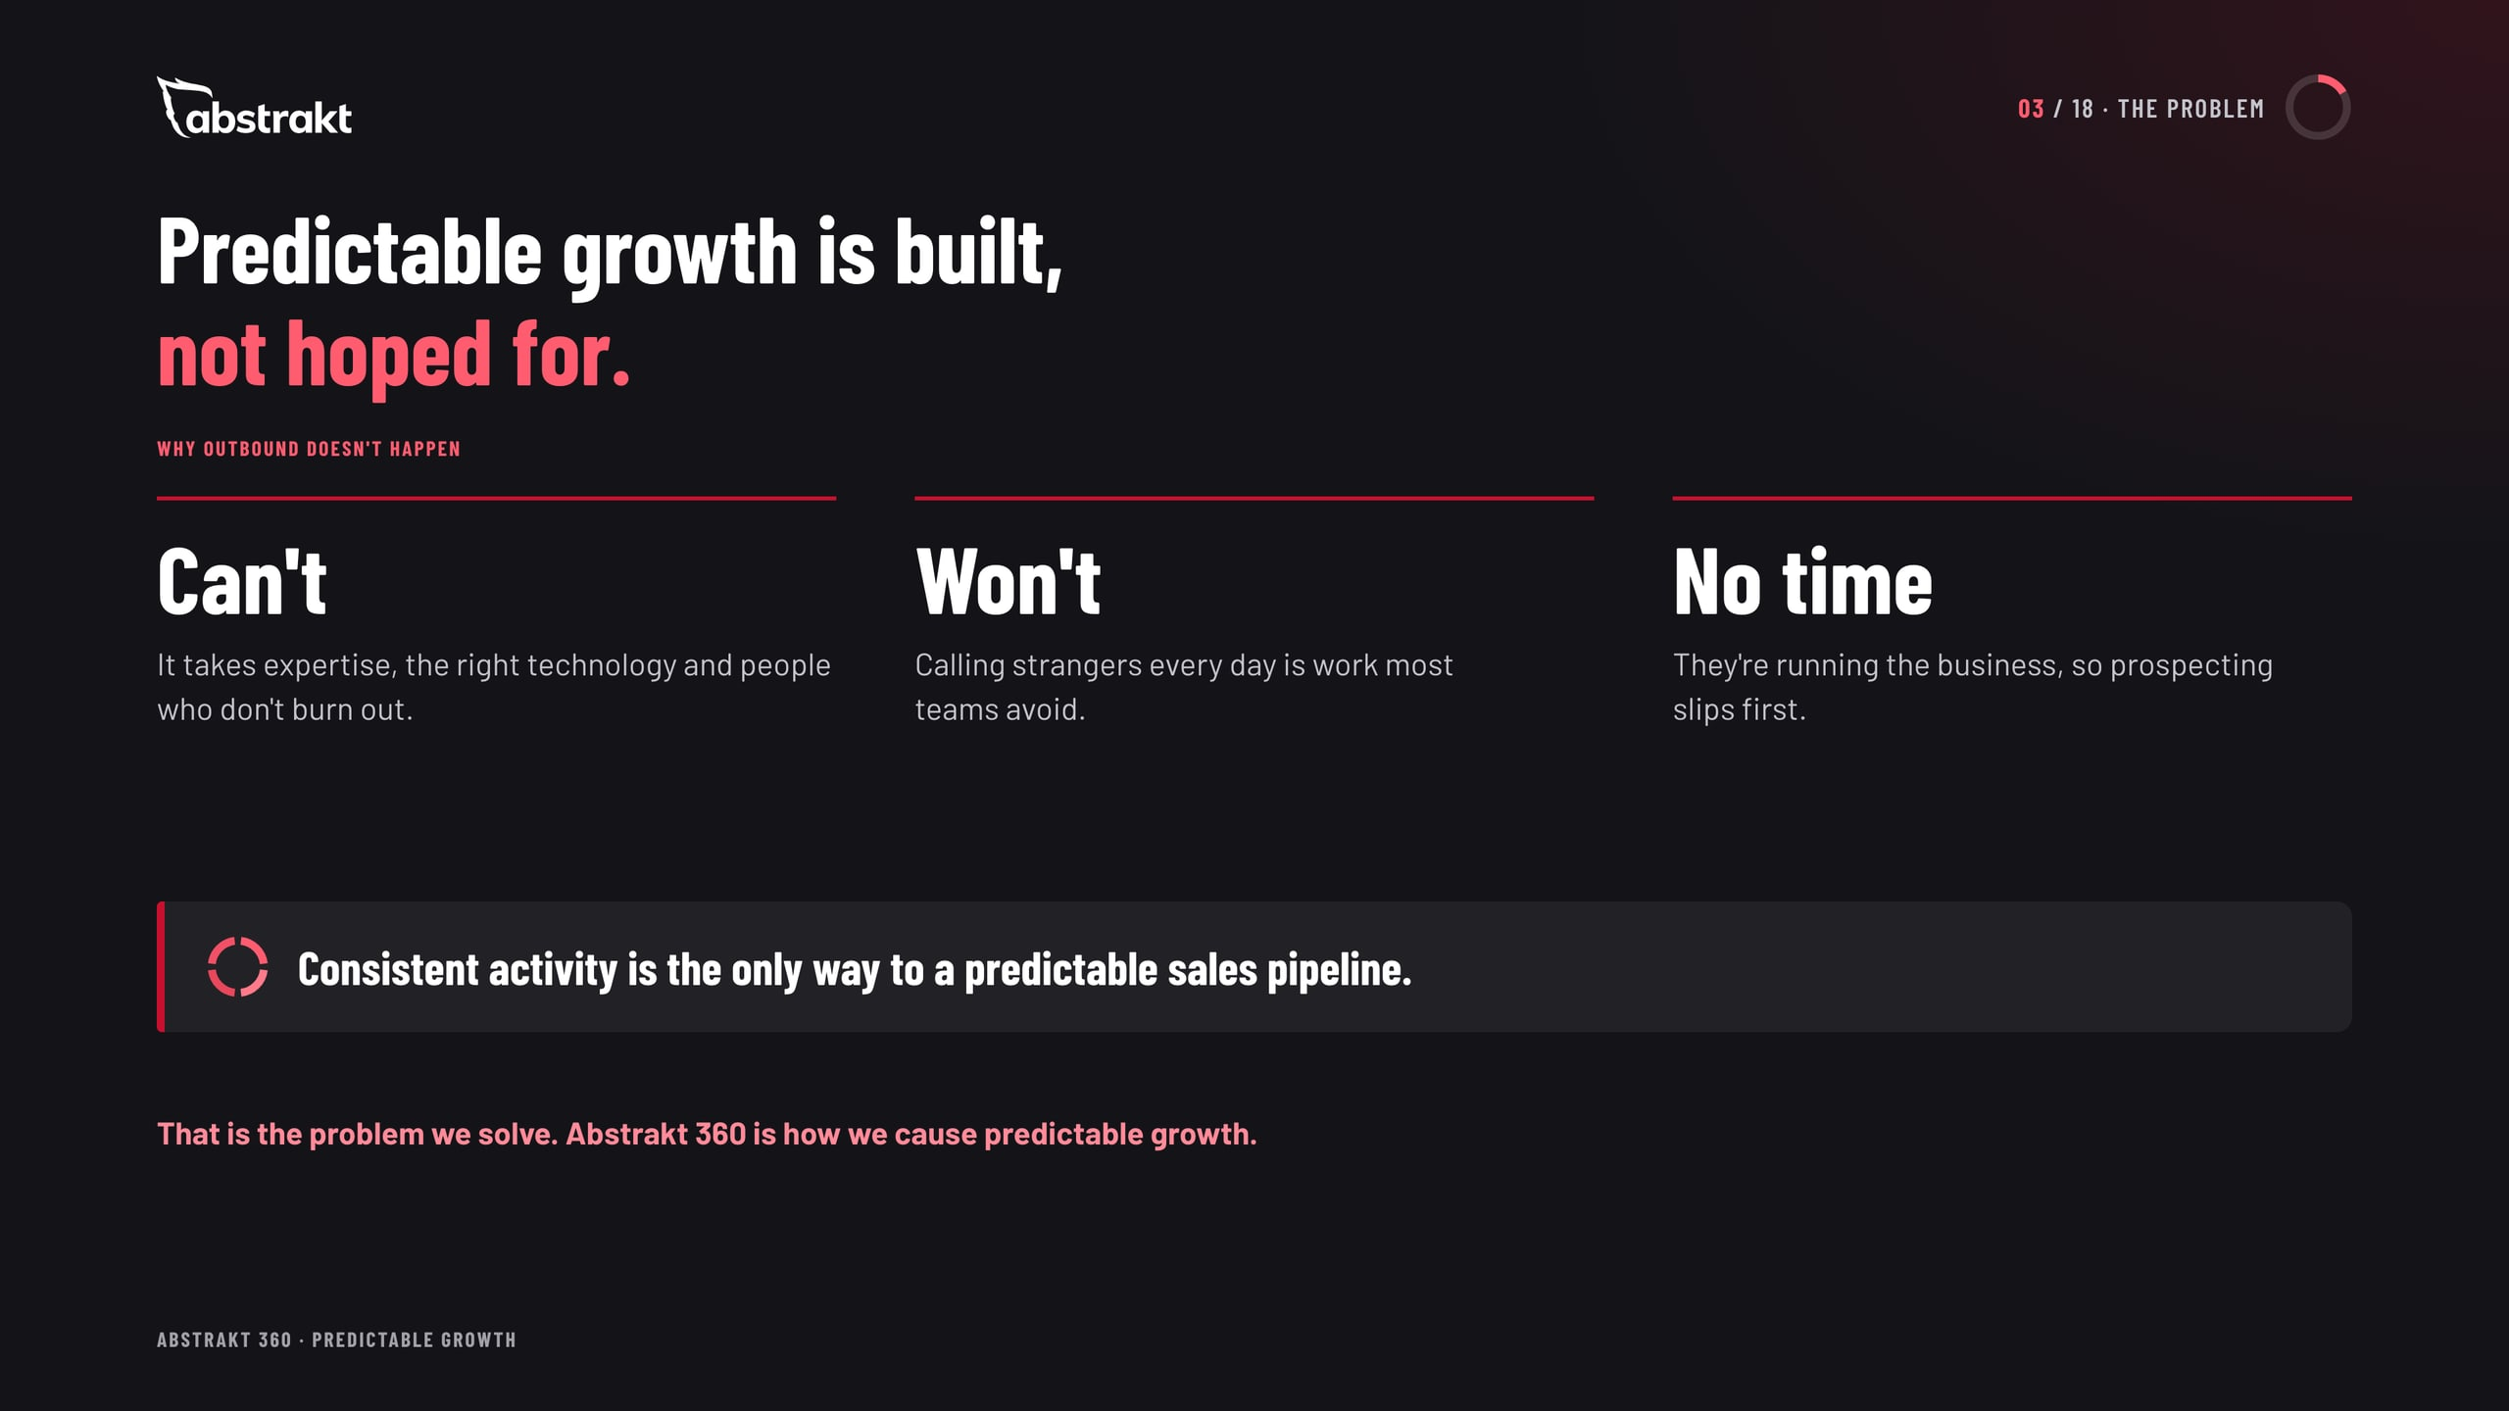
Notes:
Most companies can't do outbound well, don't want to, or are running the business and don't have time. Consistent activity is the only way to a predictable sales pipeline, and the only way to grow past client loss is to proactively build a pipeline that produces new clients over time. That is the problem we solve.

Slide 4
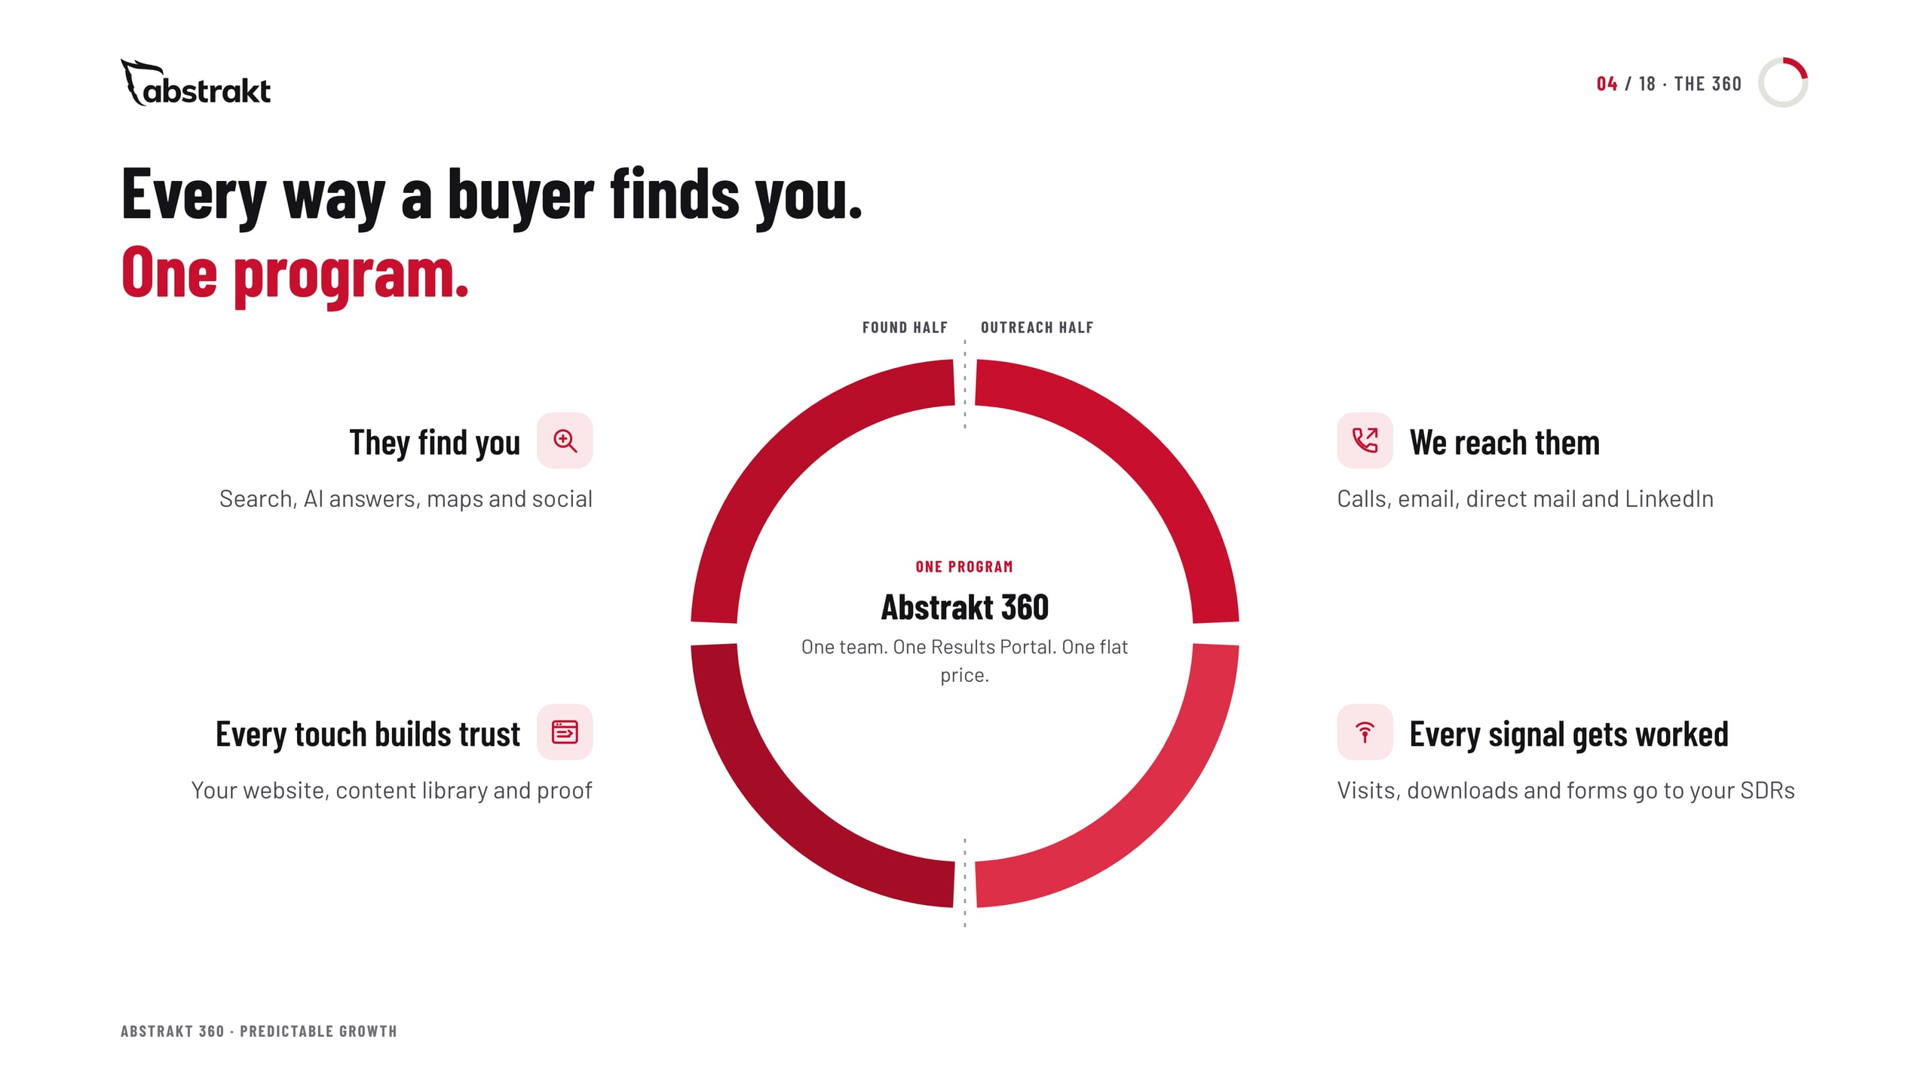
Notes:
This is the whole program on one picture. The right half is outbound: SDRs reach buyers, and the same SDRs work every signal. The left half is inbound: the website, content and search that get you found and build trust. One team, one portal, one price.

Slide 5
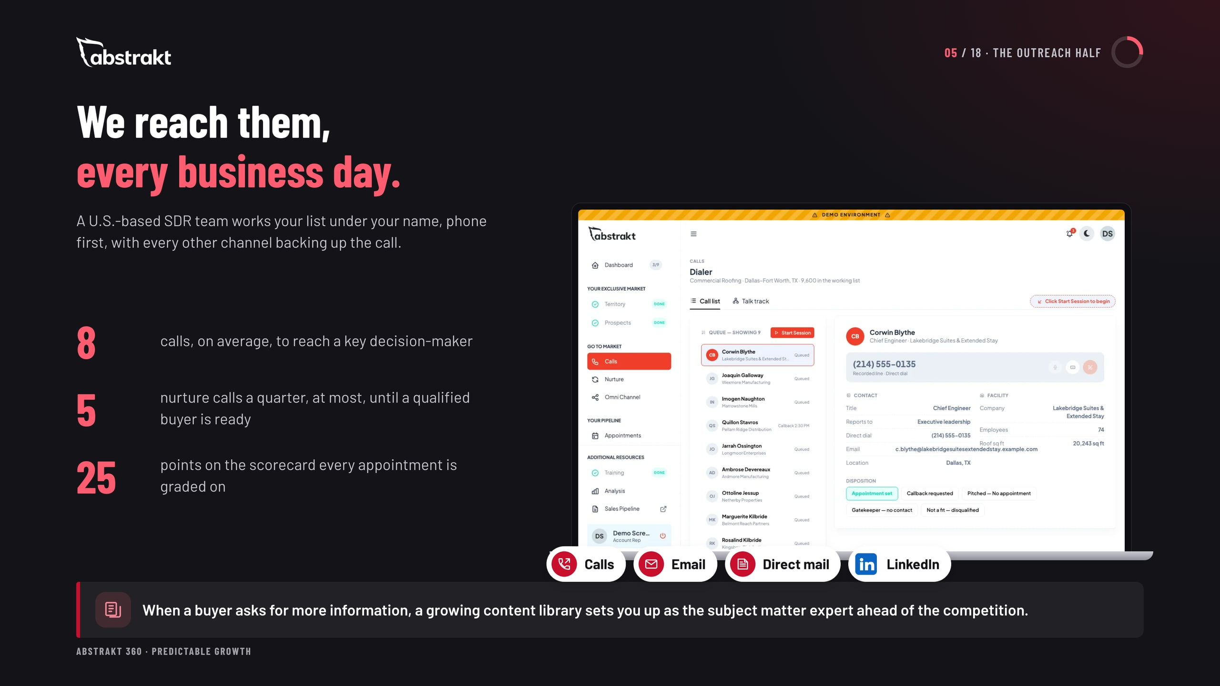
Notes:
The outreach half is the Outbound BDR program: a U.S.-based SDR team working the list every business day, phone first, with email, direct mail and LinkedIn behind every call. Point to the bridge line: the inbound half keeps adding to the content library, so the outreach never runs out of things to say.

Slide 6
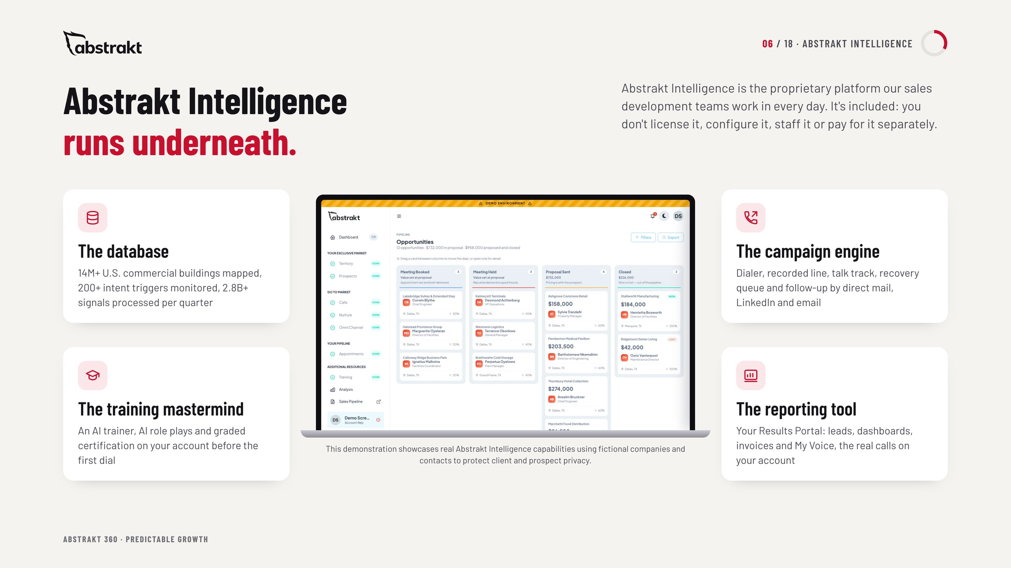
Notes:
Abstrakt Intelligence is the proprietary platform the SDR team works in: the data behind every list, the engine that runs the calls and the follow-up, the AI-assisted training and certification on the client's account, and the Results Portal the client sees. It is included; clients don't license it or pay for it separately. The screens are a demo with fictional companies.

Slide 7
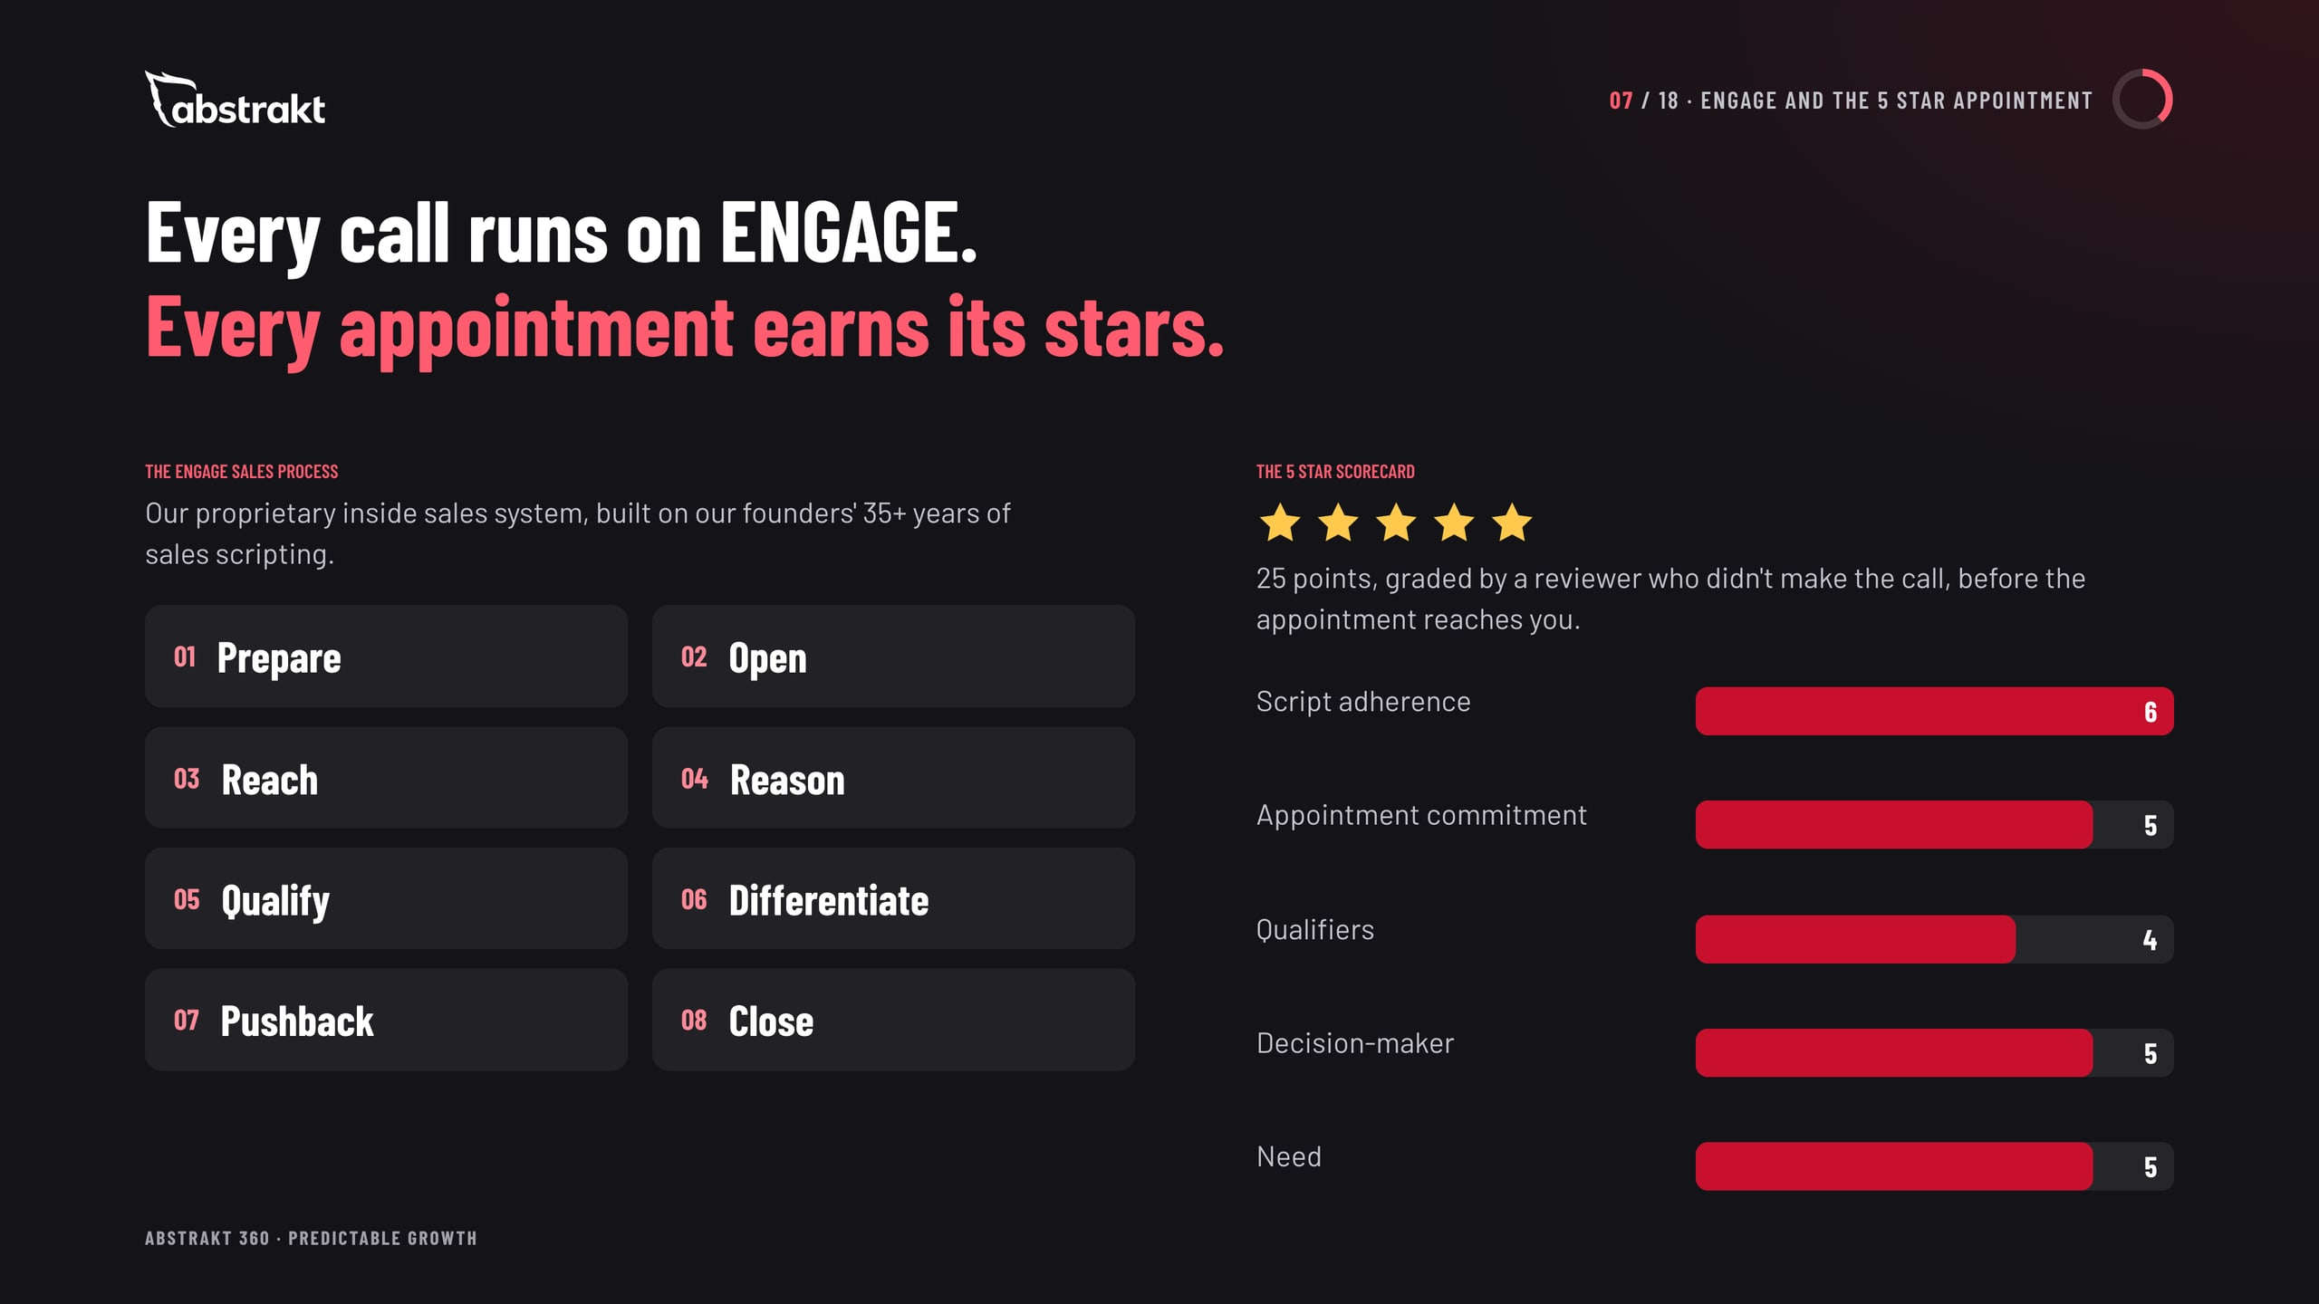
Notes:
ENGAGE is Abstrakt's proprietary inside sales system: the talk track every SDR runs on every call, eight steps from prepare to close, built on the founders' 35+ years of sales scripting. Every booked appointment is then graded on the 25-point 5 Star Scorecard by a reviewer who did not make the call: script adherence, appointment commitment, qualifiers, decision-maker and need.

Slide 8
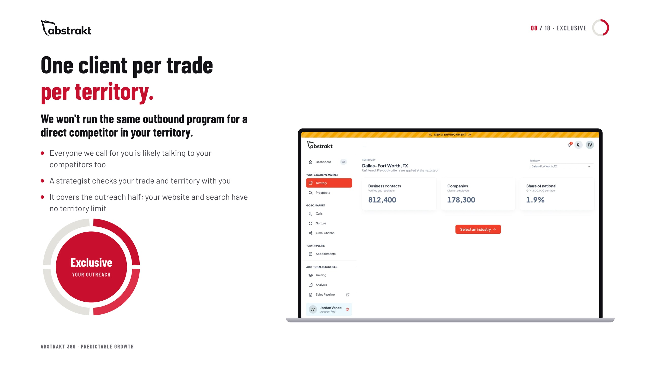
Notes:
The outreach half is exclusive: one client per trade per territory. We will not run the same outbound program for a direct competitor in your territory, because everyone we call for you is probably talking to your competitors too. A strategist checks the trade and territory. Never say a market is open or closed; never imply a local office.

Slide 9
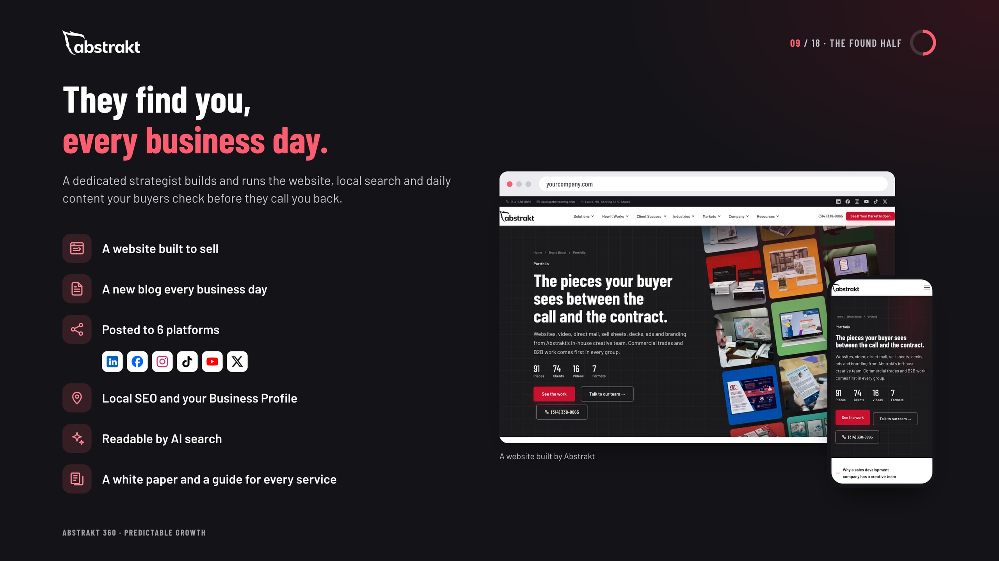
Notes:
The found half is the Inbound SDR program: the website built in the first month, a blog every business day posted to six platforms, local SEO and the Business Profile kept accurate through directory submissions and updates, AI search readability and the guides and white paper. We do not post to the Business Profile and we do not manage reviews. No promises about rankings, traffic or AI citations.

Slide 10
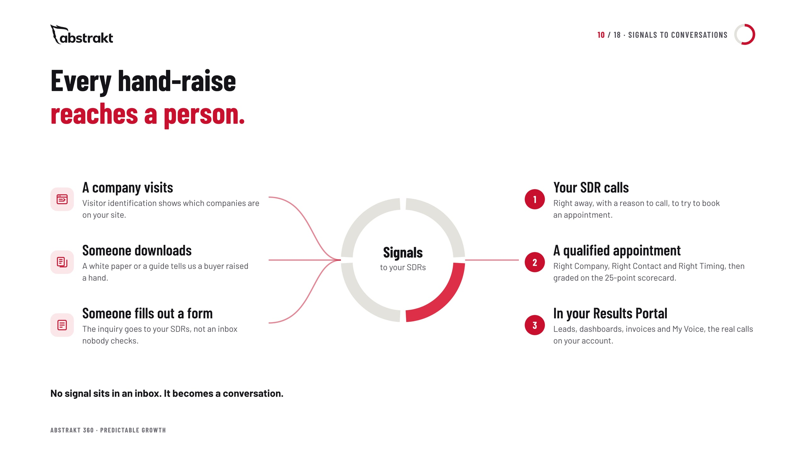
Notes:
This is the part nobody can do with two separate vendors. Once we run the website, we see which companies visit, who downloads a white paper or guide and who fills out a form, and the SDRs already working the account call them right away to try to book an appointment. No response-time promises.

Slide 11
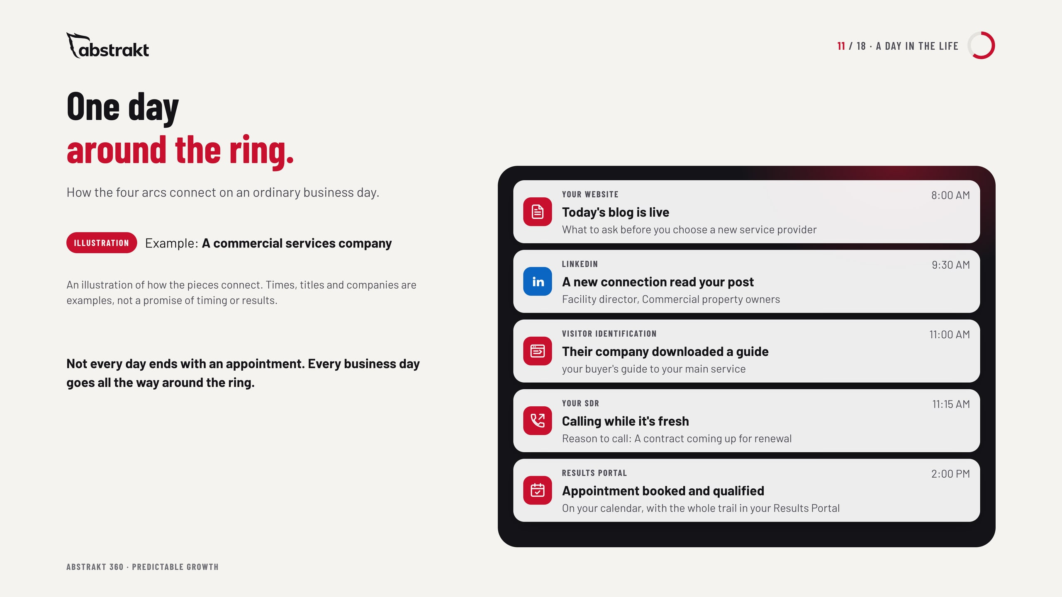
Notes:
Make the ring concrete with one ordinary day. A blog goes live and is posted to LinkedIn and five more platforms. A buyer the SDR connected with this week sees it, visits the site and downloads a guide. Visitor identification flags the company, and the SDR calls with a reason to call. Times and names are an illustration, not a promise of timing or results.

Slide 12
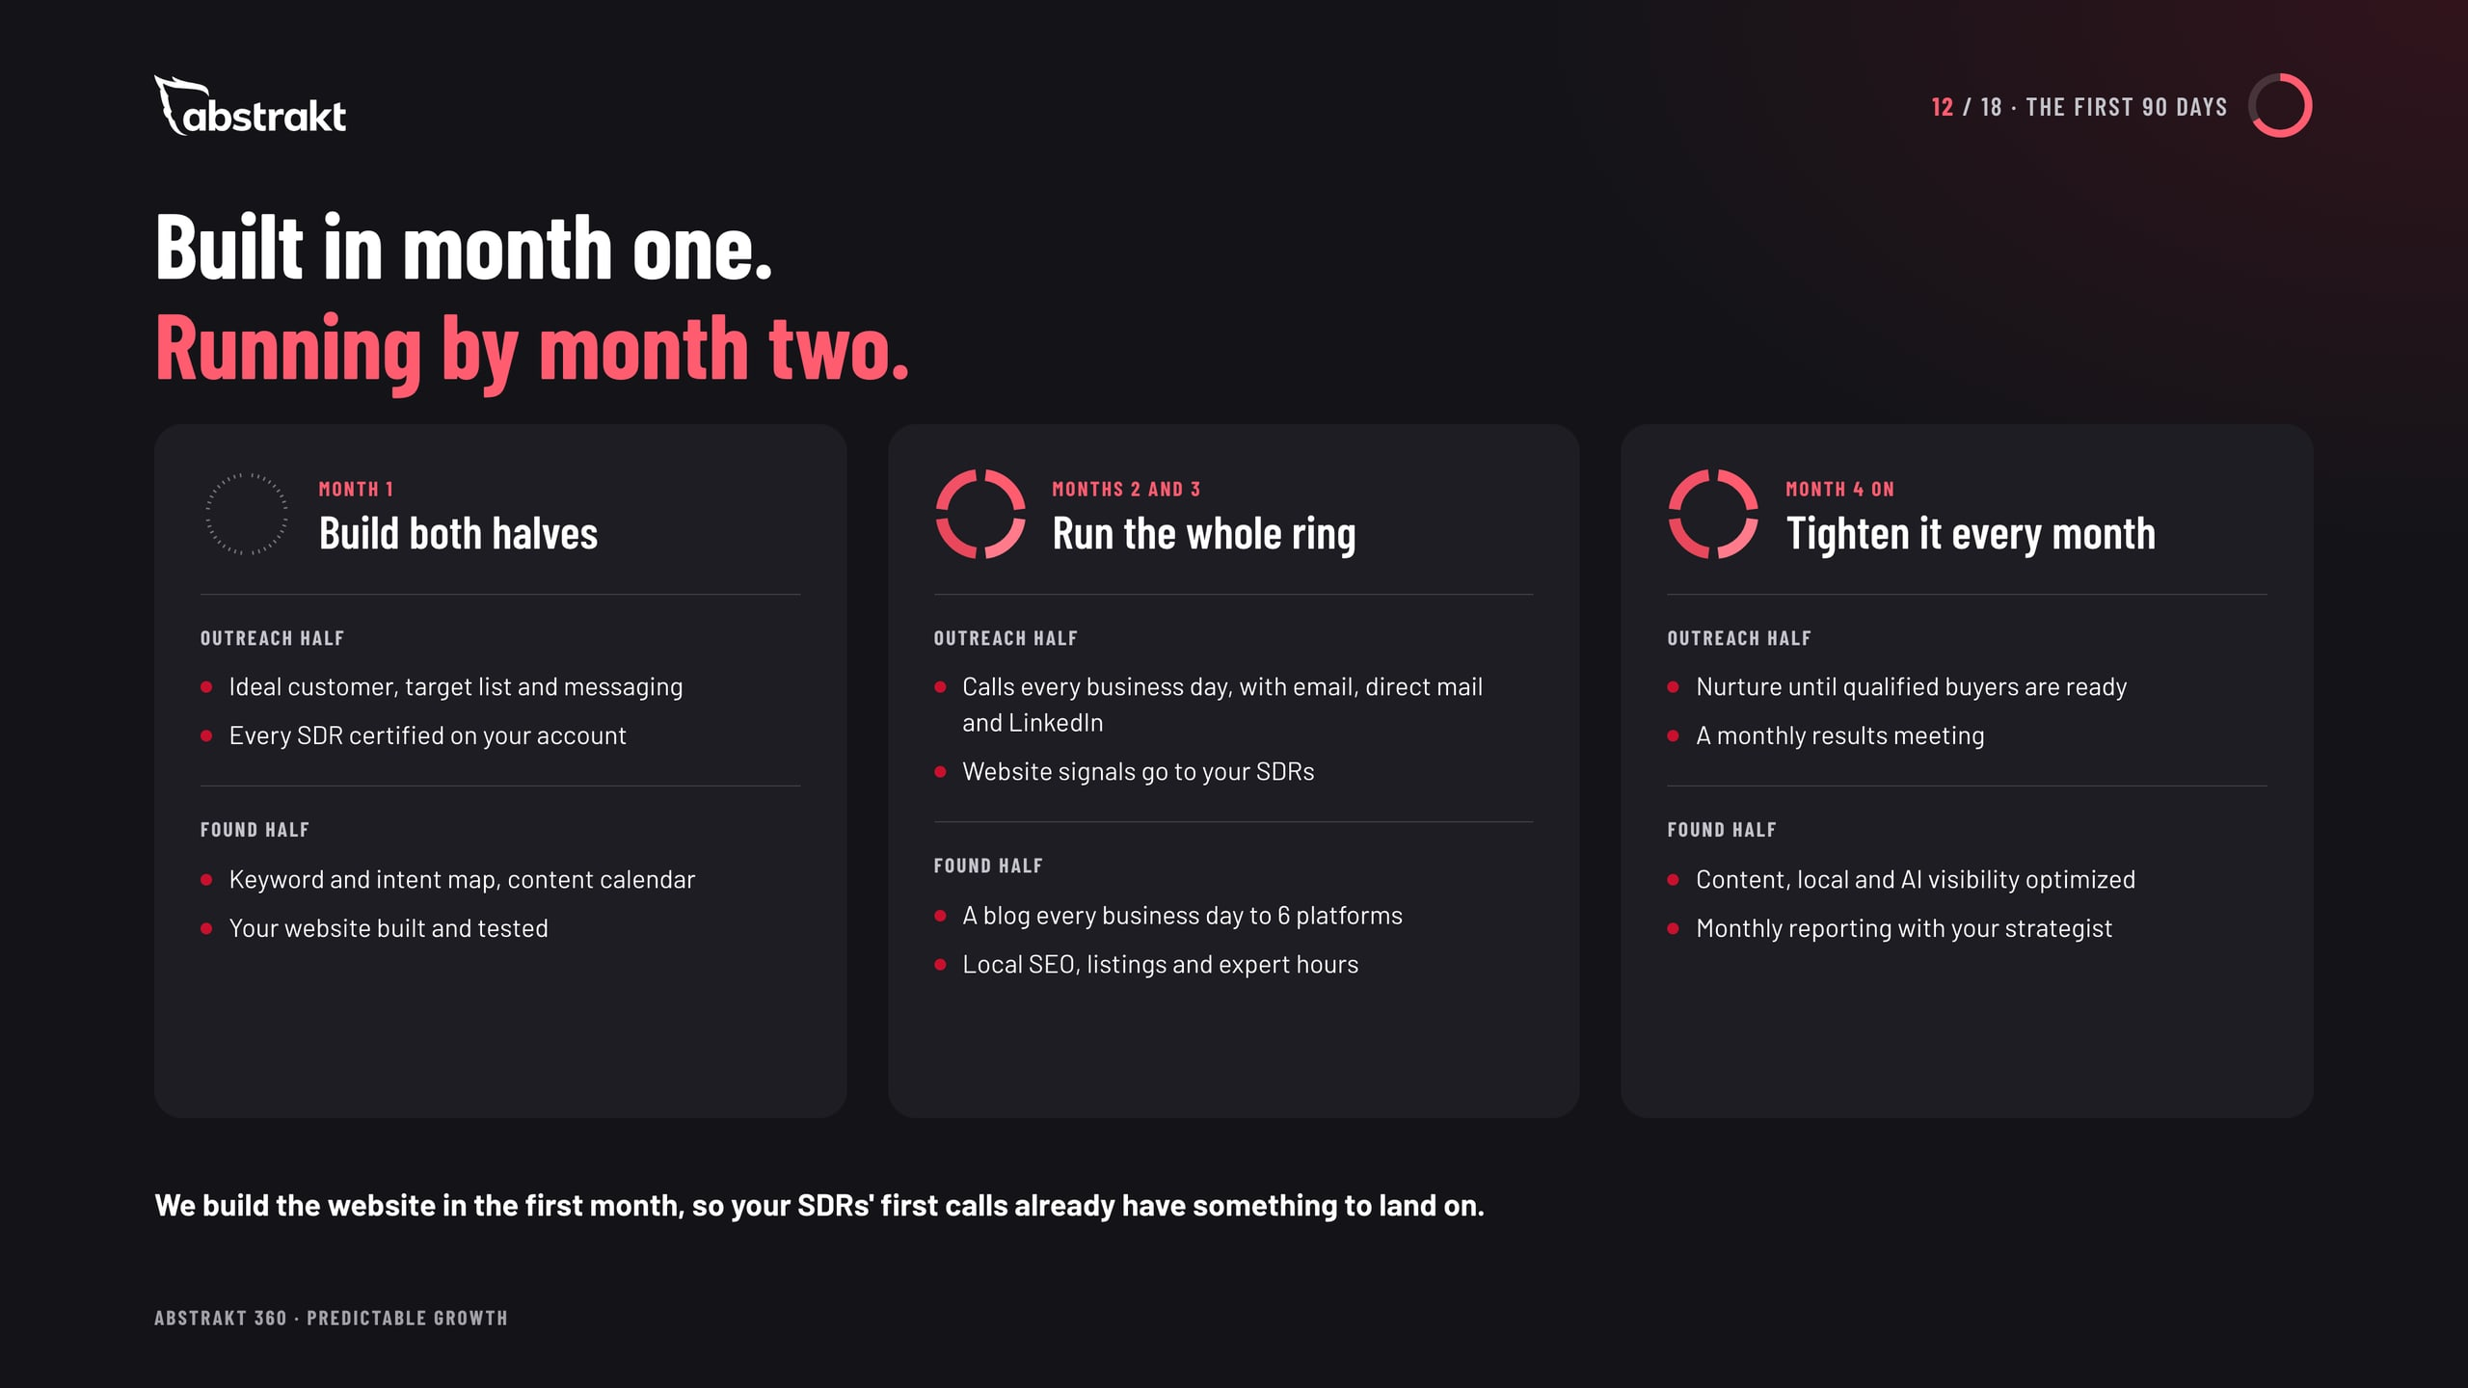
Notes:
Month one builds both halves at once: ideal customer, list and messaging, reps certified on the account, and the website built and tested. Months two and three run the whole ring. From month four, everything is tightened against the monthly results. No appointment counts or result promises.

Slide 13
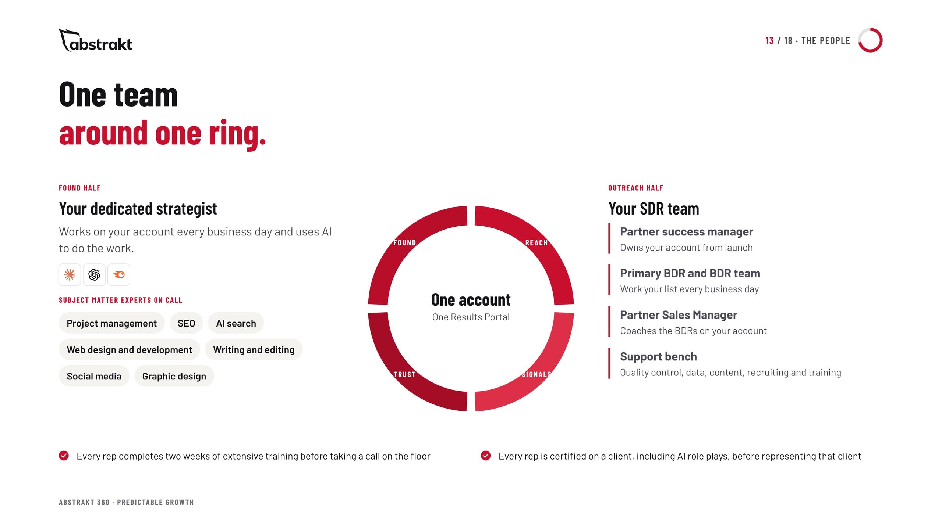
Notes:
The outreach half has a partner success manager, a primary BDR and BDR team, a Partner Sales Manager and a support bench. The found half has one dedicated strategist who works on the account every business day, uses AI to do the work, and calls on subject matter experts when the work needs them. The experts are on call, not assigned to the account.

Slide 14
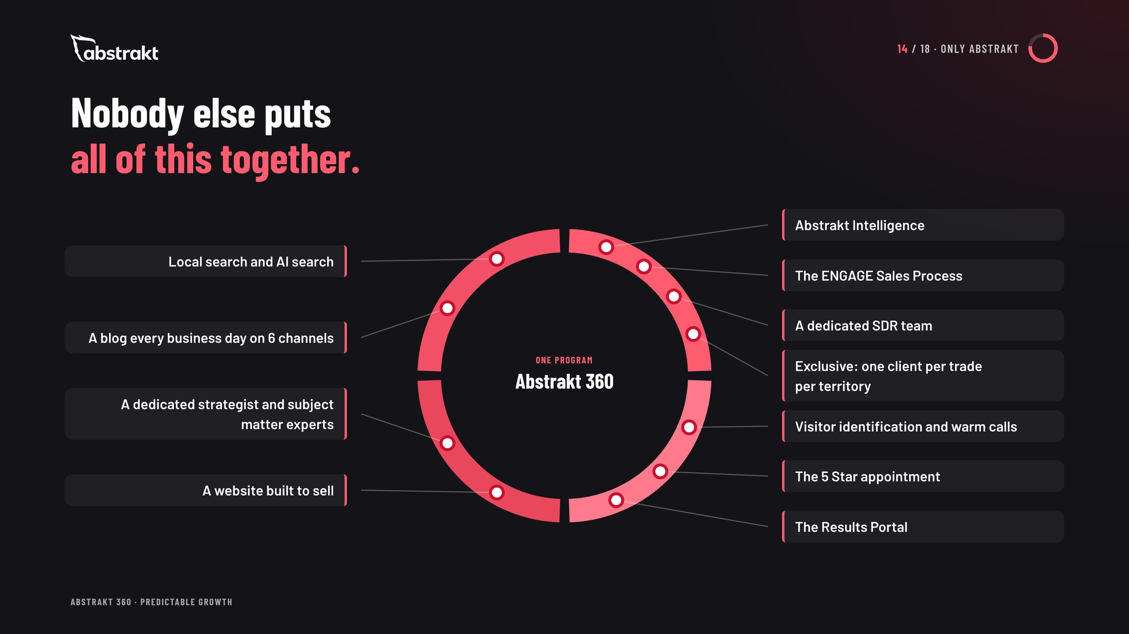
Notes:
This is the moment to be proud. Abstrakt Intelligence, the ENGAGE Sales Process, the 5 Star appointment, a dedicated SDR team, a dedicated strategist with subject matter experts, the website, daily content on six channels, local and AI search, visitor identification and warm calls, the Results Portal, and exclusivity: one client per trade per territory. All of it in one program, run by one team (Scott, 2026-10-14). Do not name or criticize competitors.

Slide 15
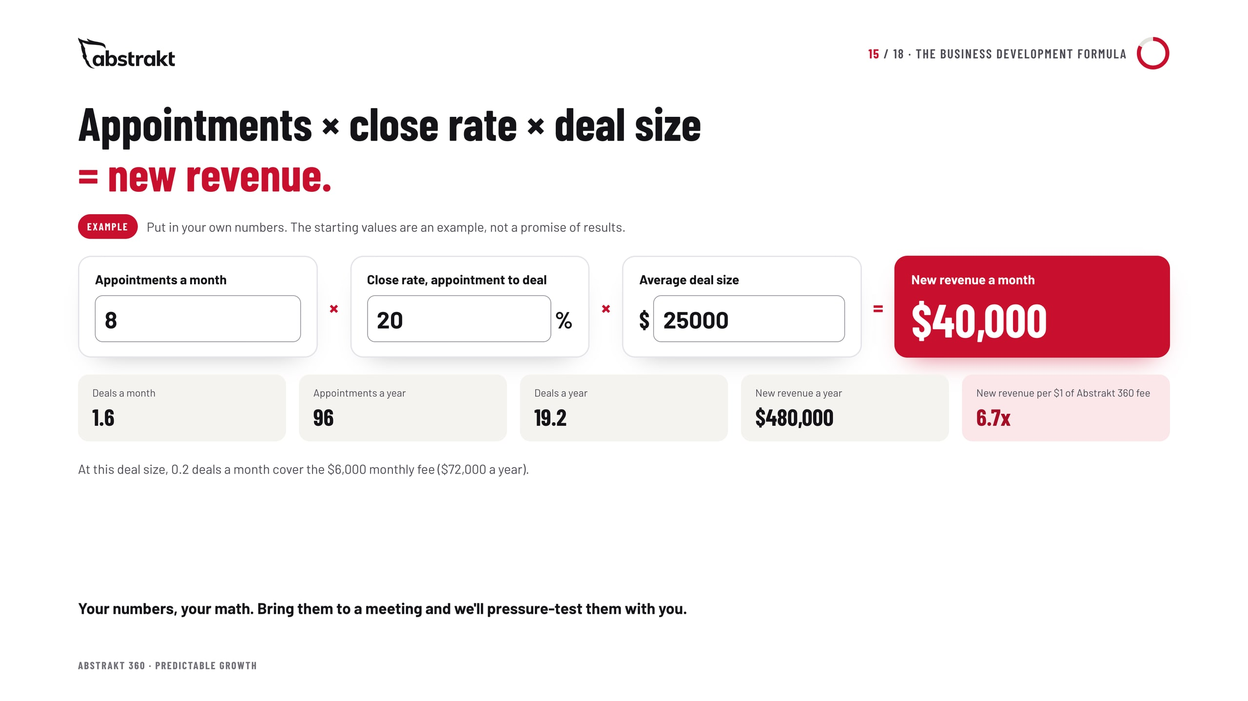
Notes:
This is the visitor's own math. Appointments a month times their close rate from appointment to deal times their average deal size gives new revenue a month; times twelve for the year. The starting values (8 appointments a month, a 20 percent close rate and a $25,000 deal) are the same example the site's appointment cost calculator starts with. They are not a forecast or a promise of results.

Slide 16
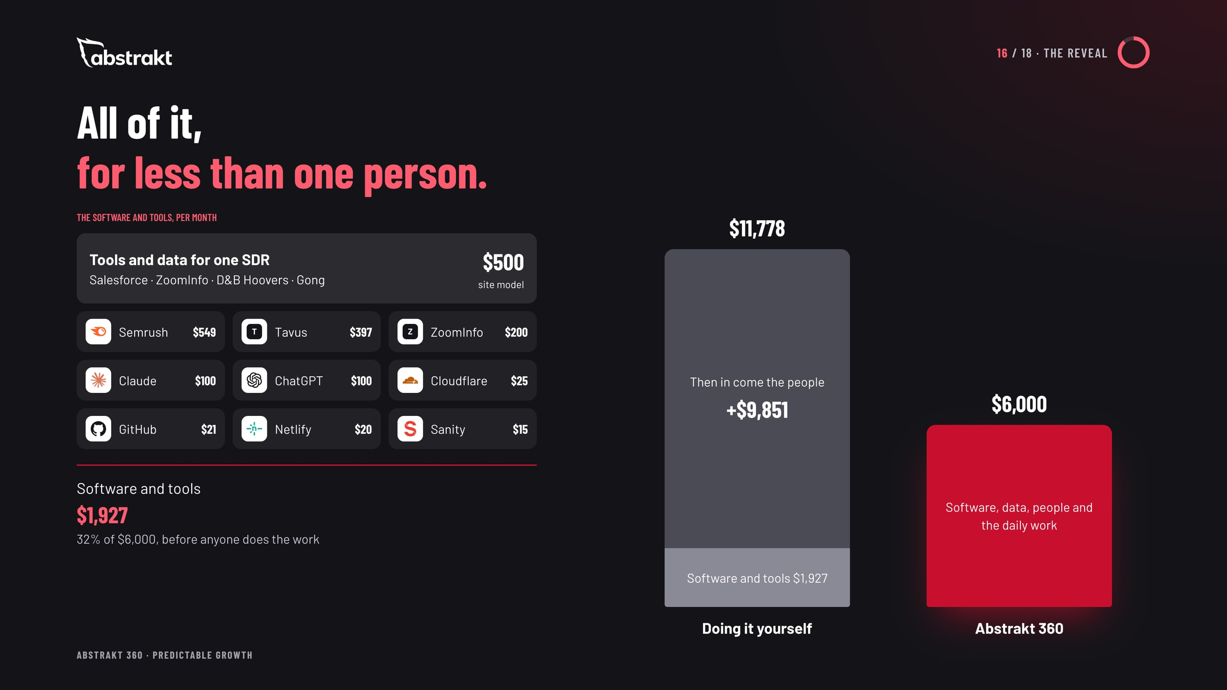
Notes:
Build the cost up the way a buyer would. The software and tools for both halves come first: the inbound stack at vendors' list prices and the site model's tools-and-data line for one SDR. That alone is about a third of the Abstrakt 360 price, before anyone does the work. Then come the people: one in-house SDR, by the site's model at the middle metro's median pay (illustrative). Abstrakt 360 is less than that one person, with the software, data, people and daily work included.

Slide 17
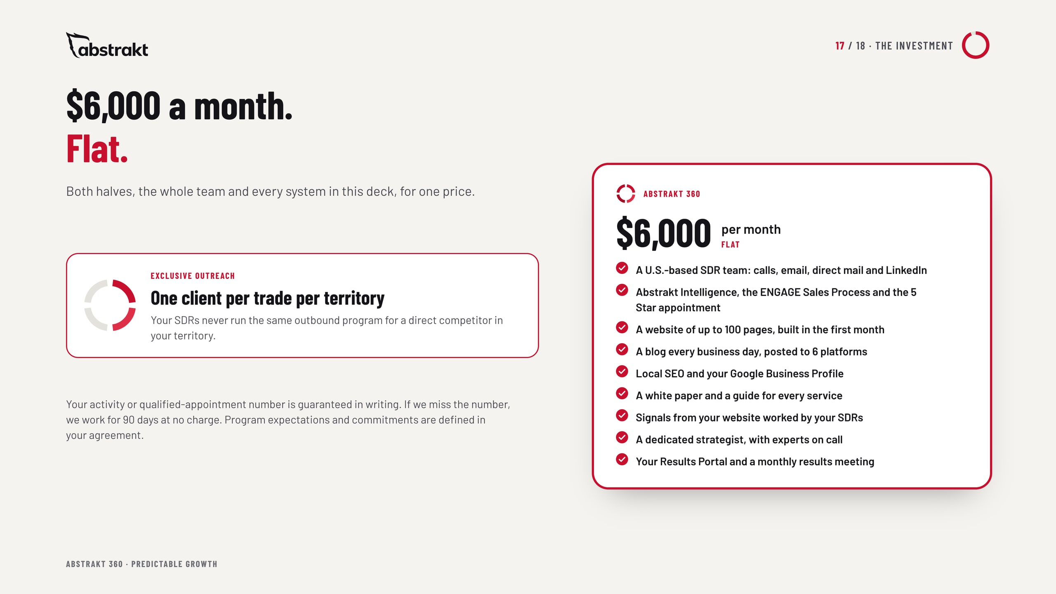
Notes:
One flat monthly price for both halves, the whole team and every system. The outreach half is exclusive: one client per trade per territory. The outbound guarantee: a number agreed in writing, and if we miss it, we work for 90 days at no charge.

Slide 18
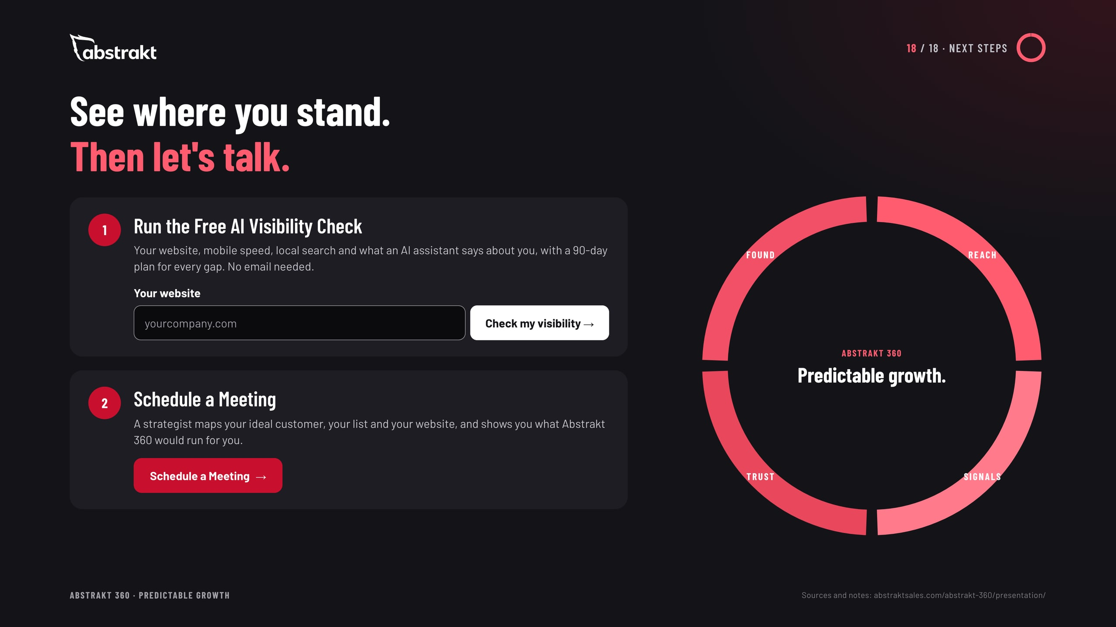
Notes:
Two next steps. The Free AI Visibility Check shows how the found half looks today, with a 90-day plan for every gap. Then schedule a meeting with a strategist to map the ideal customer, the list and the website. Ask for the meeting.

